Slide 1
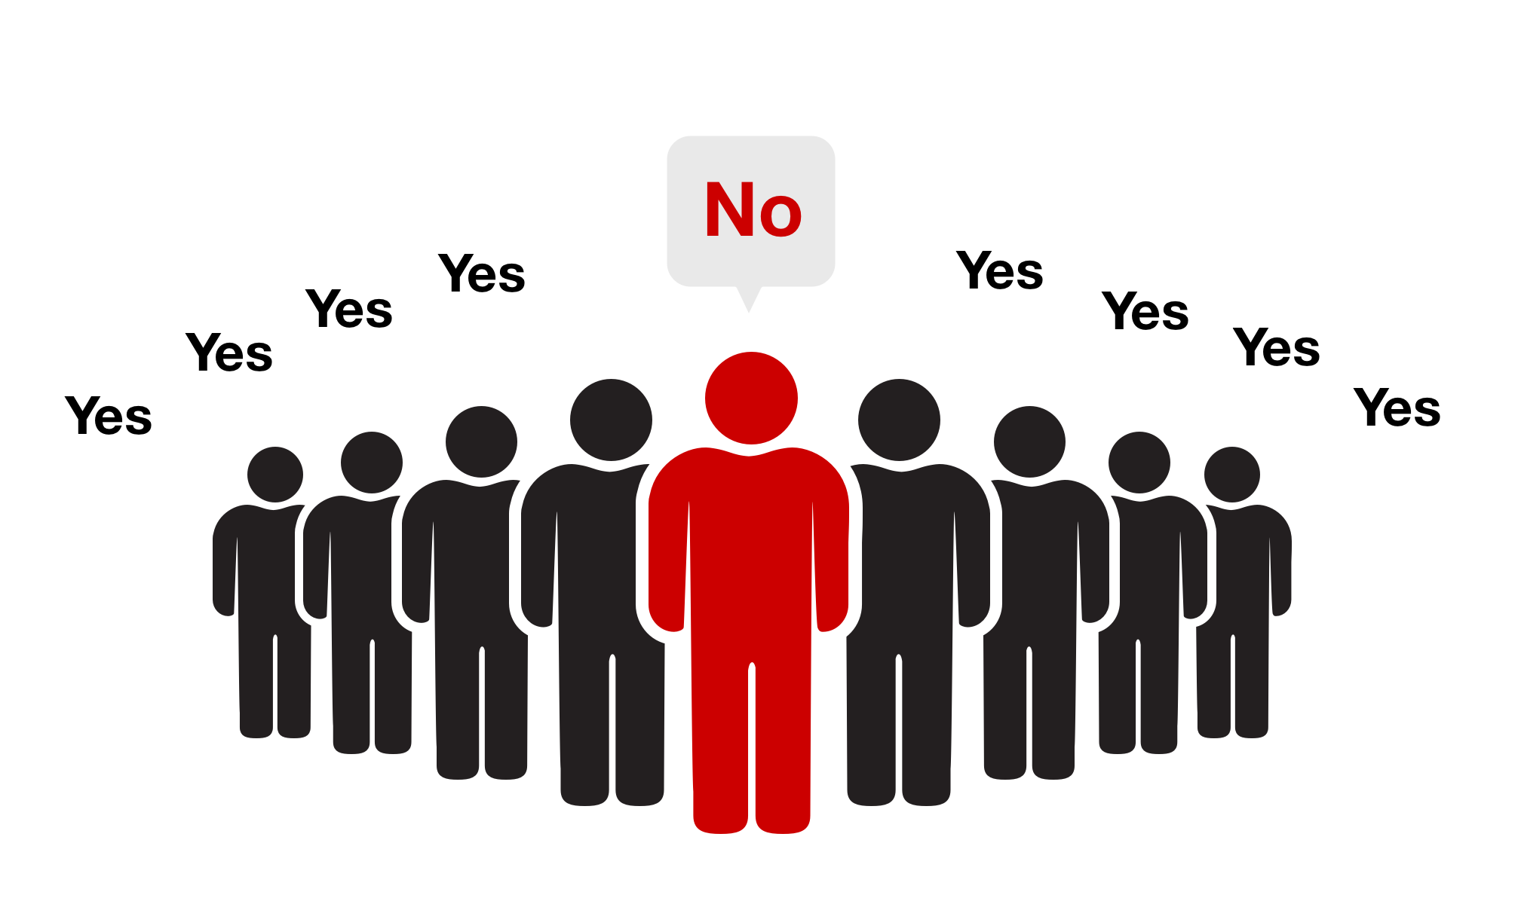

Slide 2

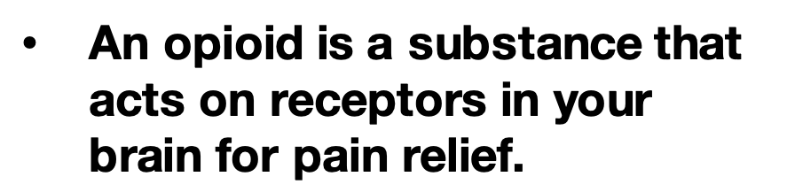
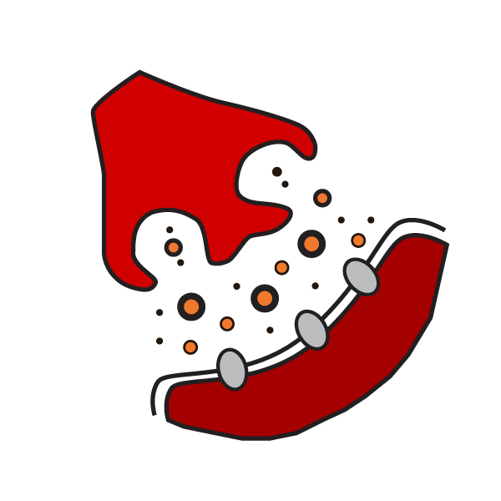

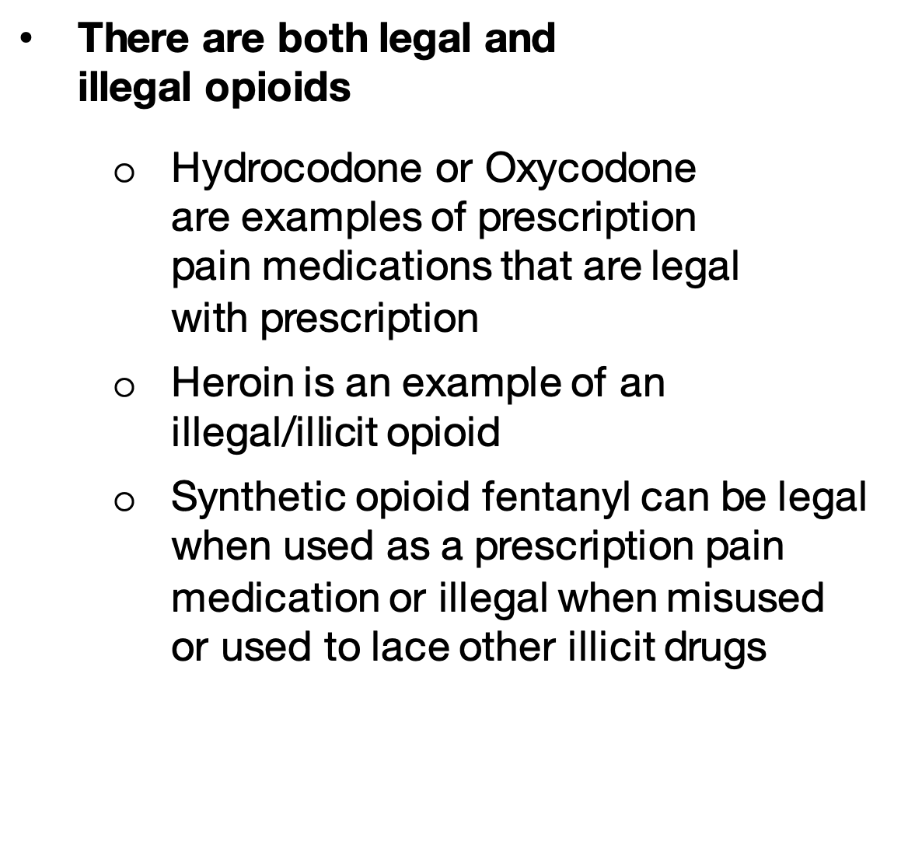


An opioid is a substance that acts on receptors in your brain for pain relief.
There are both legal and
illegal opioids
  Hydrocodone or Oxycodone
  are examples of prescription
  pain medications that are legal
  with prescription
  Heroin is an example of an
  illegal/illicit opioid
  Synthetic opioid fentanyl can be legal when used as a prescription pain medication or illegal when misused or used to lace other illicit drugs
Notes:
Instructor Notes:
Ask 2-3 students to share what they remember about what opioids are and how they work. As students share, confirm their responses or address any misconceptions.
Click to remind students that an opioid is a substance that acts on receptors in your brain for pain relief. There are illegal forms like heroin and those that are legal with a prescription, like Oxycodone or Hydrocodone. There is also synthetic opioid fentanyl, which is approved by the Federal Drug Administration (FDA) as a prescription pain medication but is more often used to dangerously lace other illegal/illicit drugs, like heroin or fake pills.
Key Talking Points:
-Opioids can be both legal (e.g. prescription opioids) and illegal (e.g. heroin).
-Opioids bind to receptors in the brain.
-Opioids can decrease pain, increase pleasure, and slow automatic body processes, like breathing.
- Review that opioids block pain messages to the brain by binding to opioid receptors. Opioids can have three main effects: decreased feelings of pain, increased feelings of pleasure, and slowed automatic processes, like breathing.

Slide 3

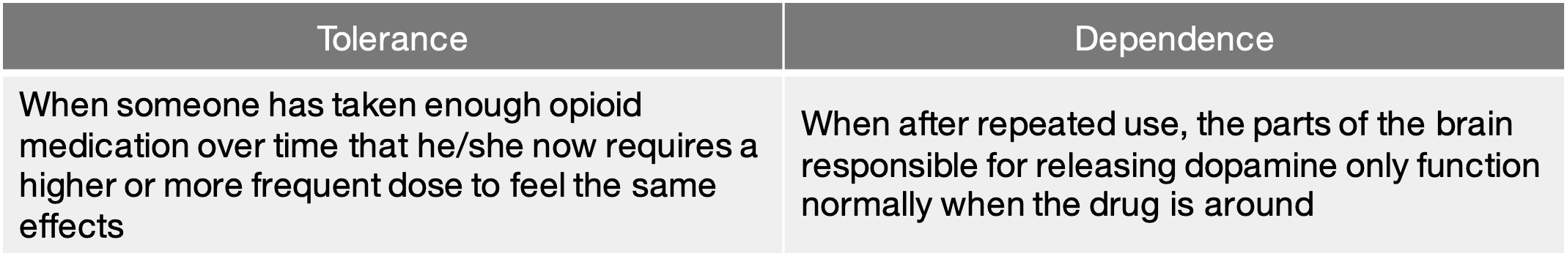
Tolerance | Dependence
When someone has taken enough opioid medication over time that he/she now requires a higher or more frequent dose to feel the same effects | When after repeated use, the parts of the brain responsible for releasing dopamine only function normally when the drug is around
Notes:
Instructor notes:
Click to review the information in the table. Tolerance is when the body requires higher or more frequent dosages to gain the same effect- like needing more gold stars to feel as happy as you did before. Dependence is when the parts of the brain responsible for releasing dopamine only function normally when the drug is taken.
Key Talking Points:
-Tolerance is when one requires higher or more frequent dosages to experience the same effects of a drug.
-Opioid dependence is when the brain can only release dopamine if the drug is present.
Source: https://www.thetruth.com/o/articles/opioid-addiction

Slide 4

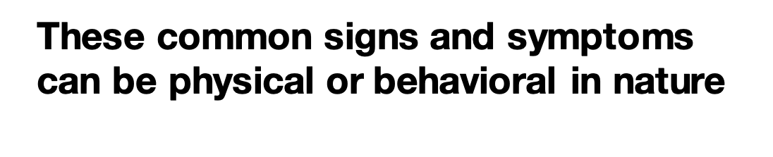
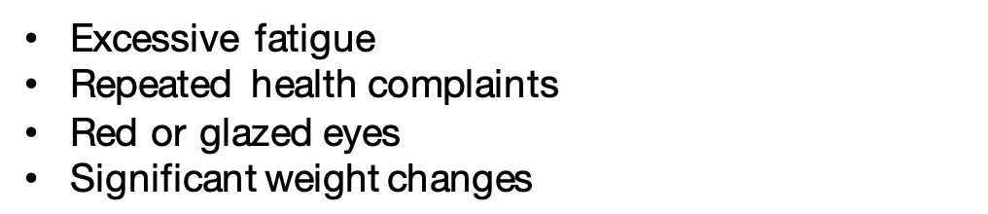

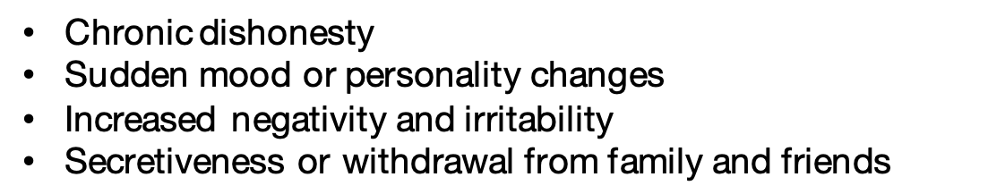

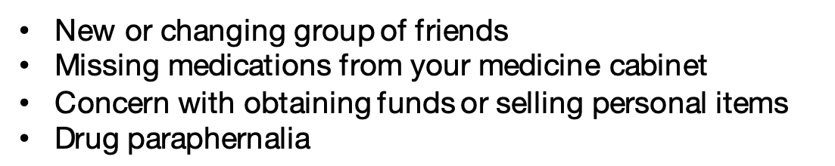

Excessive fatigue
Repeated health complaints
Red or glazed eyes
Significant weight changes
Physical
Chronic dishonesty
Sudden mood or personality changes
Increased negativity and irritability
Secretiveness or withdrawal from family and friends
Behavioral
New or changing group of friends
Missing medications from your medicine cabinet
Concern with obtaining funds or selling personal items
Drug paraphernalia
Other Signs
& Symptoms
Notes:
Instructor notes:
Now that students have explored opioids’ effects on the body and substance misuse, they will learn other common signs and symptoms of an individual misusing substances, like opioids.
Click to reveal some of the physical signs/symptoms of substance misuse.
Click again and explain the behavioral signs/symptoms of substance misuse.
Lastly, click to reveal other common signs and symptoms of misusing opioids.
Key Talking Points:
Common signs and symptoms of substance misuse can be physical, behavioral, or be displayed in new habits or preoccupations.

Slide 5
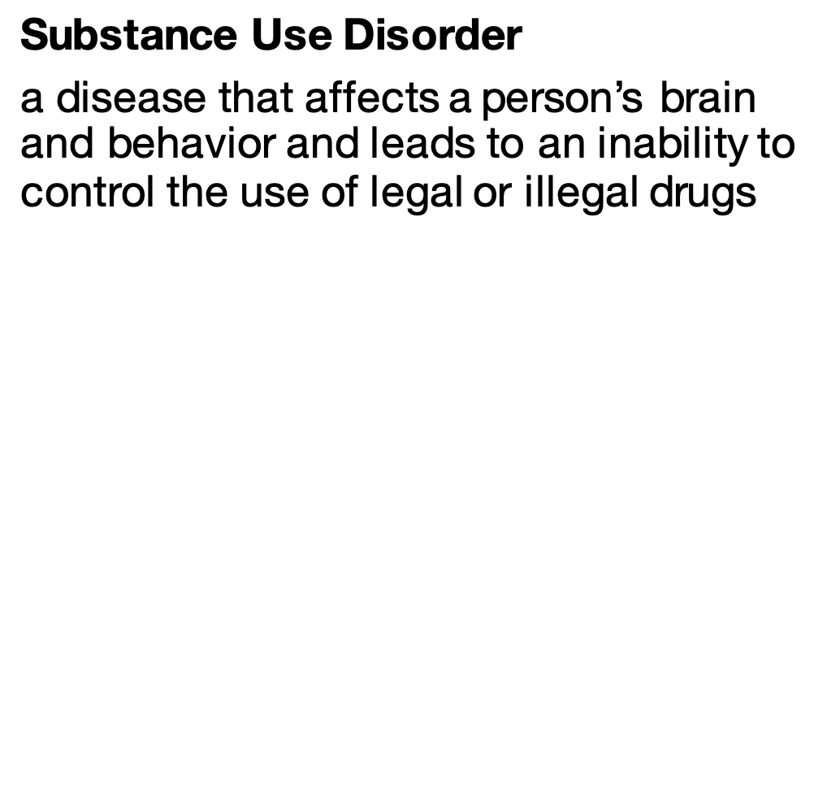
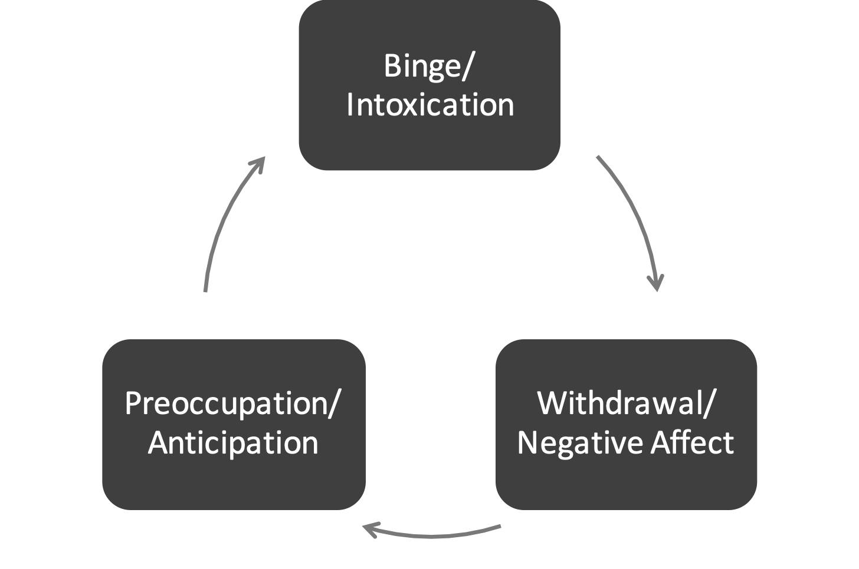
Binge/ Intoxication
Withdrawal/ Negative Affect
Preoccupation/ Anticipation
Notes:
Instructor Notes:
Now let’s explore how misusing a drug, building tolerance, and becoming dependent can lead to substance use disorder or addiction.
Remind students that substance use disorder (SUD) is a disease that affects a person’s brain and behavior and leads to an inability to control the use of legal or illegal drugs. This is a disease with repeated actions that will cause the nerve cells to communicate differently— it is a cycle.
Click and direct students’ attention to the image depicting the cycle of substance use disorder. Review that SUD makes the brain want to recreate the feelings it experiences when the drug is present. Regardless of the consequences, a person with substance use disorder will continue to seek a drug. One has to take more of a substance to obtain the same dopamine "high" because his/her brain has adapted. Reinforce that this is known as tolerance. As a result, they will increase the amount of the substance they take in an effort to achieve the high they are used to.
When they are not taking the substance, people will experience withdrawal, causing them to feel severe physical and emotional distress. Eventually, the person’s brain can no longer function as it should without the presence of the substance. They will become extremely preoccupied or obsessed with thinking about how they will get their next fix so that they can avoid withdrawal and just be able to function.
These changes in the brain remain even after substance misuse stops and explain why it can be so difficult for someone to stop using and for relapse to occur. With the right support, treatment, and care, recovery is possible!
Reinforce to students that addiction is a brain disease NOT a moral failing. Ask the students to share what they learned previously around stigma and the negative impact it can have. Reinforce to students that it's important that they recognize the words we use matter. Instead of using stigmatizing terms, like addict or junkie, use person-first language like “a person with a substance use disorder". No matter the situation, no one likes to feel judged or devalued. In order to encourage people to reach out for help, it's important to reduce the stigma surrounding their situation.
Key Talking Points:
-Substance use disorder is a disease that affects a person’s brain and behavior.
-This disease creates a cycle, often referred to as the “cycle of addiction.”
-The words we use matter. Instead of using a stigmatizing term, like addict or junkie, use person-first language like “a person with a substance use disorder.”

Slide 6

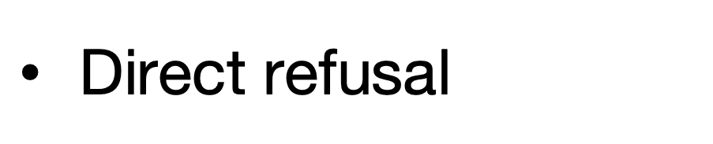
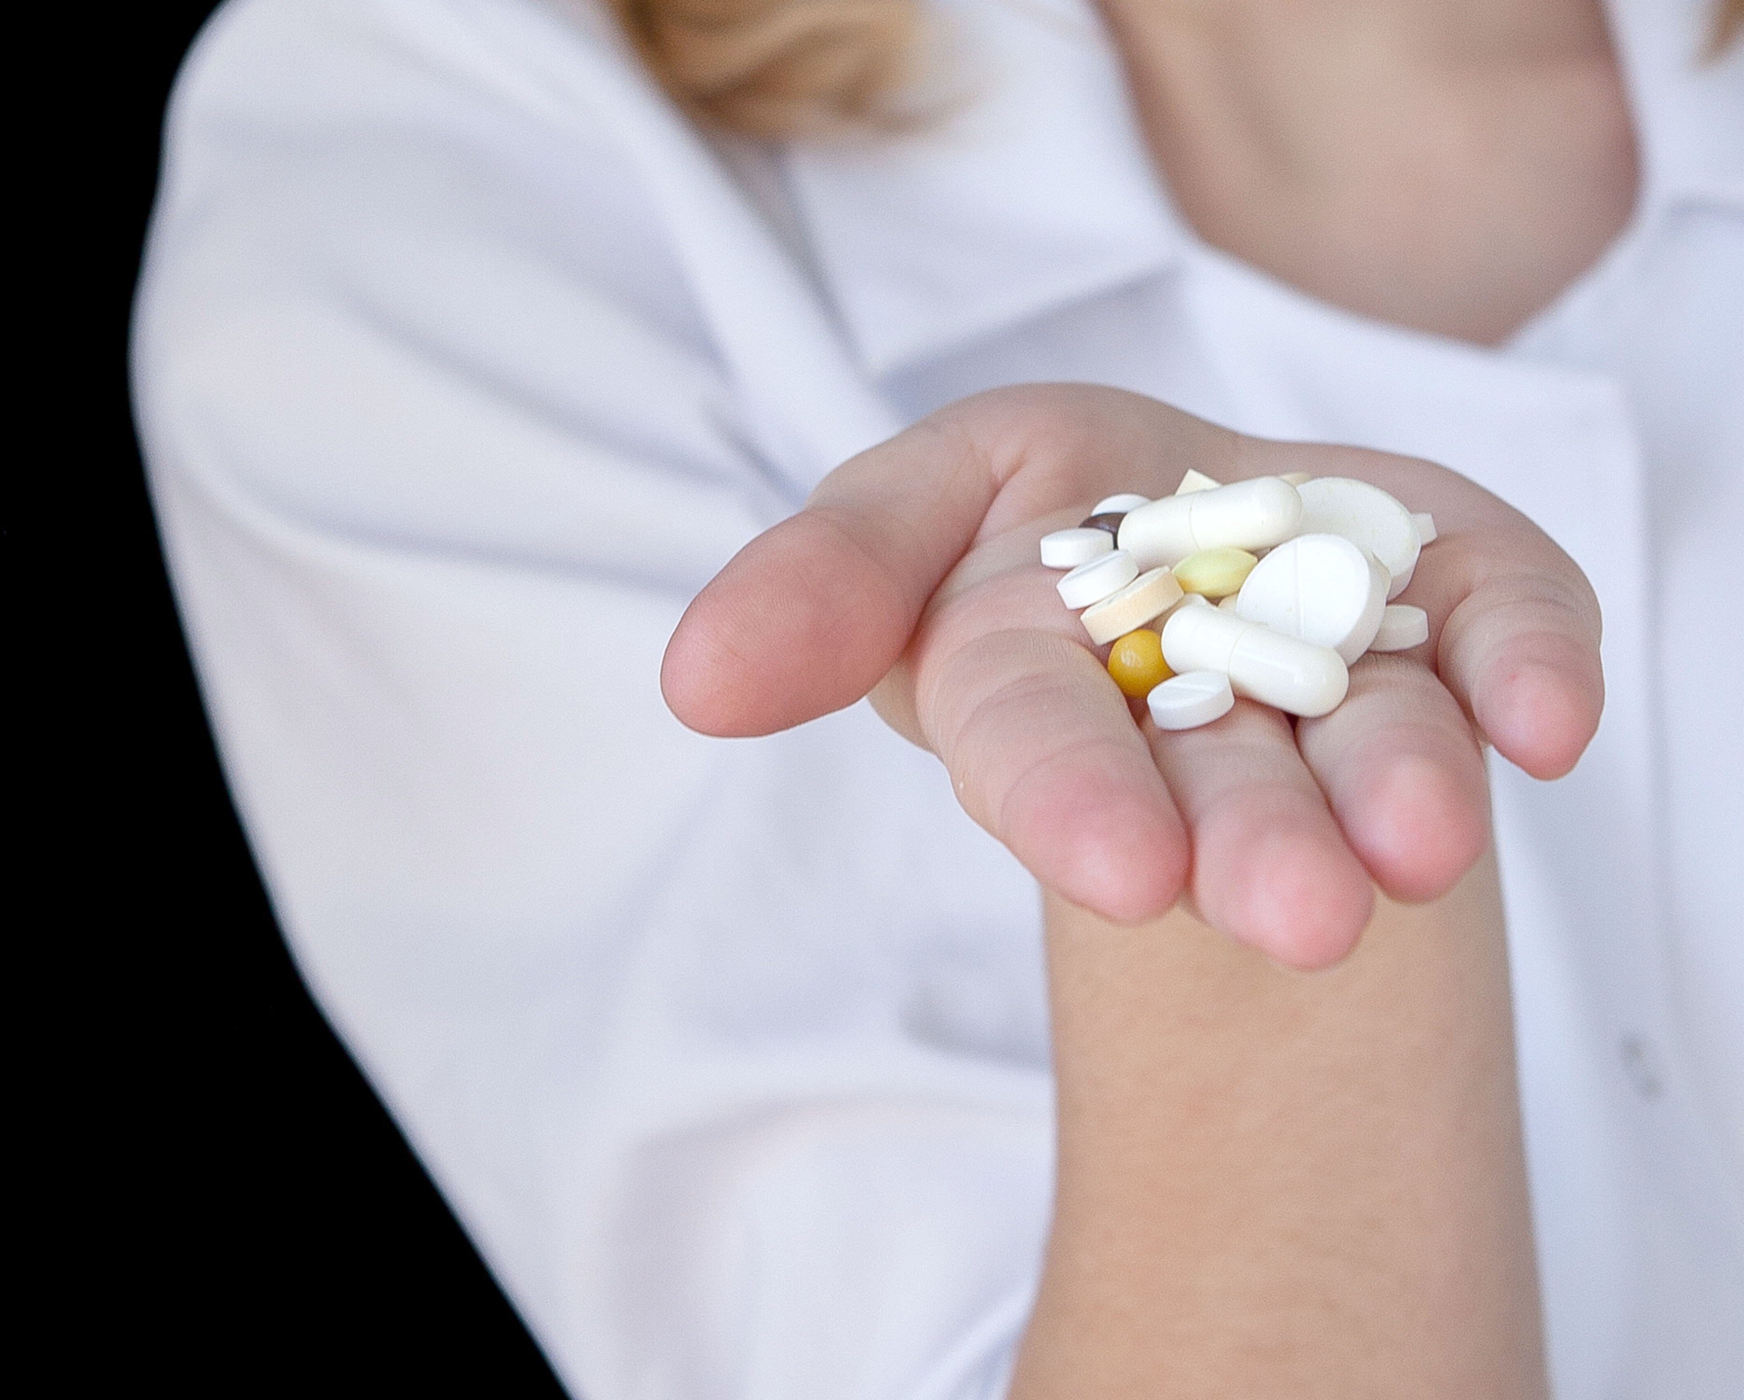

Direct refusal
Exit strategies
Notes:
Instructor Notes:
Invite 2 or 3 volunteers to share suggestions of what students can do if they are presented with the opportunity to misuse drugs or are offered drugs that weren’t prescribed to them.
Click to show “Direct refusal.” Reinforce if any of the suggestions provided were direct refusals. Explain that a direct refusal is saying “No” or “No, thank you.”
Note: If necessary, reinforce with students that “I don’t think so” and “Not right now” are indirect refusals, as they still leave open the possibility of a positive response.
Click again to show “Exit strategies.” Reinforce any of the suggestions provided that were exit strategies. Explain that an exit strategy is a plan to get out of or away from a potentially dangerous situation. It can also include relying on others for help, like friends or trusted adults.
Key talking points
-Direct refusal is the most efficient way to say no to drugs.
-An exit strategy is a plan to remove yourself from a situation.
-Rely on others, like friends and trusted adults, to help you exit potentially dangerous situations.

Slide 7

Notes:
Instructor Notes:
Inform students that they will be watching a short video about the most effective ways to say no to drugs.
Click to show the video.
Following the video, invite students to comment on their key takeaways. Did they learn anything new? Did what they watched reinforce what they have learned in this lesson?
Key talking points:
-A persuasive technique is when someone tries to get you to do something or agree to something that you don’t usually do.
-A direct refusal is when you say no or no thanks.
-If a simple ‘No’ does not work, you can exit the situation or reach out to a loved one for help.

Slide 8

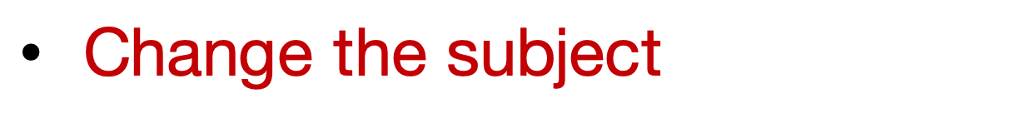


Change the subject
Suggest doing something else
Use humor or sarcasm
Notes:
Instructor Notes:
Sometimes saying no, especially to family and friends, can be uncomfortable. Let’s brainstorm other ways we can say “No.”
Ask students to turn to a partner and brainstorm other ways to say no when offered drugs. Invite volunteers to share their thoughts, and record responses on the board.
If not offered during the brainstorming session, click to reveal the suggestions listed on the slide.
Key talking point:
Students may use other ways to say no to drugs, including distractions, humor or sarcasm.

Slide 9
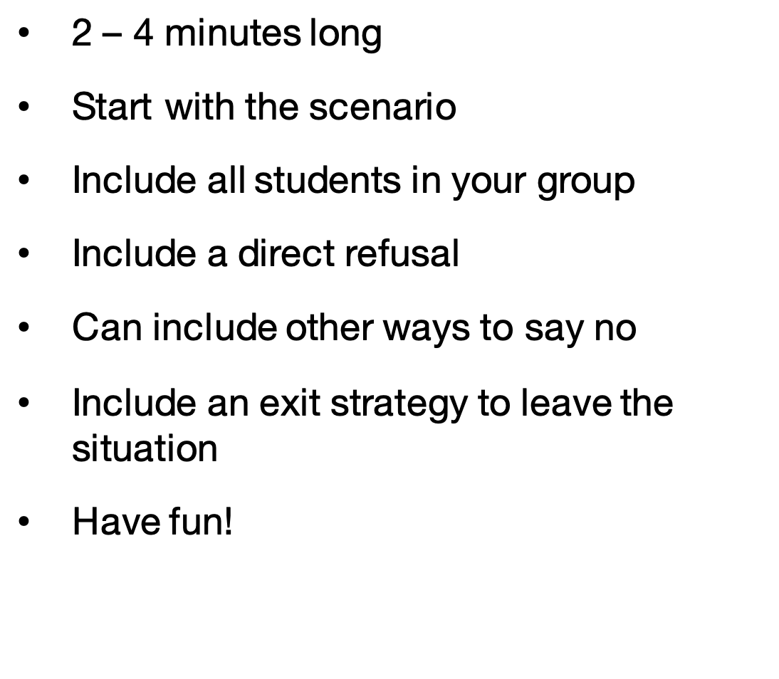



2 – 4 minutes long
Start with the scenario
Include all students in your group
Include a direct refusal
Can include other ways to say no
Include an exit strategy to leave the situation
Have fun!
Notes:
Instructor Notes:
Divide students into five groups by having them count off as 1 to 5. All of the 1s are in a group, all of the 2s are in a group, and so on.
Explain that there is a possibility they will be offered the opportunity to misuse drugs at some point in their lives, and it is important to be ready to respond. Therefore, they will be practicing direct refusal and exit strategies by acting in short skits based on given scenarios.
Distribute a Peer Pressure Scenario handout to each group.
Assign each group the scenario that matches their group number and give each student in the group a copy of their scenario.
Click once and review the requirements of their skits. Take 1-2 minutes to answer clarifying questions.
Allowing 3 minutes per group skit and 2 minutes for discussion and reflection after each skit, check the clock to determine how much time to allow students to work on their peer pressure skits.
Click again to reveal a timer. Enter the time you are giving students to complete their planning sheets and click to start.
Technology Note: If you are using a printed version of the PowerPoint presentation, use a stopwatch or smartphone clock app to keep time.
Remind students that they should leave themselves enough time to practice their routines at least once.
As students work, the pharmacist/educator should rotate throughout the classroom and provide each group with brief feedback on their work. Alternatively, a pharmacist/educator can be “assigned” to each group to engage with them through the duration of the activity or even participate in the skit.
Alert students when there are 10 minutes remaining to work, 5 minutes, and then 2 minutes.
Adjust the timer by entering the animation settings > animation pane. Change the timing of the ‘Oval’. Note: the timing has to be entered in seconds.

Slide 10

Notes:
Instructor Notes:
Provide the opportunity for each group to present its skit to the class.
Note: If time does not allow for the whole class to watch each presentation, match groups together to swap. See “Pharmacist/Educator Prep” section for more details.
Following each skit, ask the other groups if they have anything to add or any questions to ask.
When there are approximately 5-10 minutes remaining, instruct students to return to their seats.

Slide 11
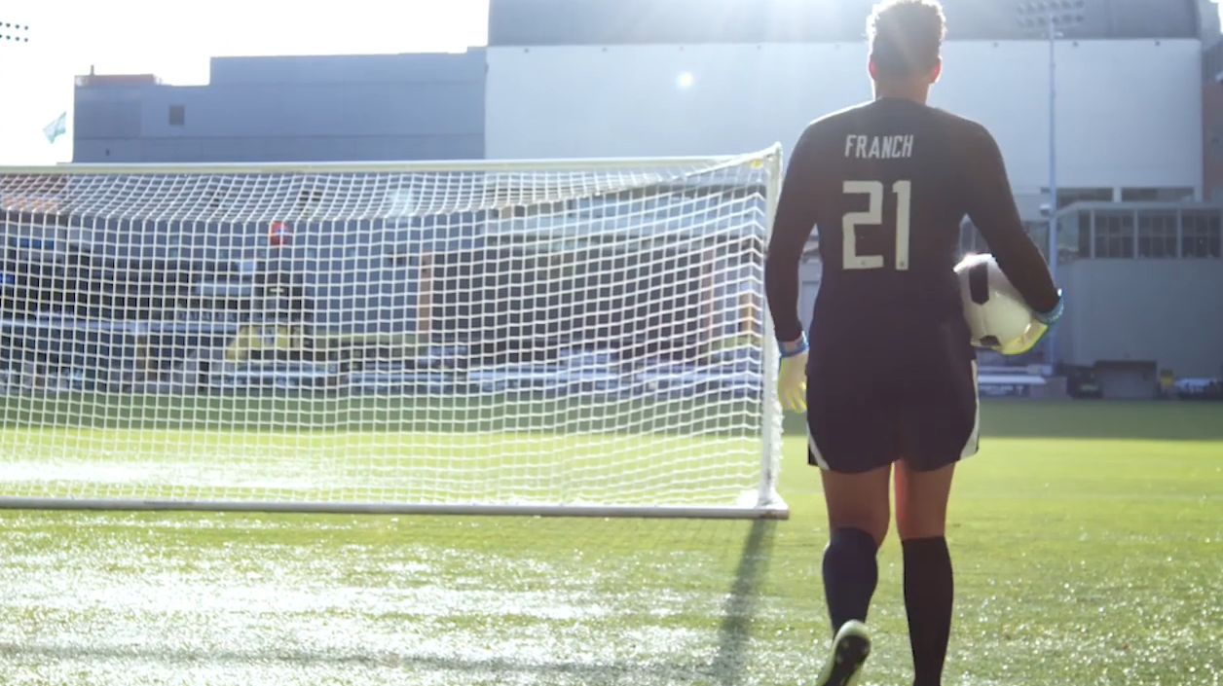
Notes:
Instructor Notes:
Click to play the video featuring US soccer star Adrianna Franch. Reinforce that friends that pressure you to misuse drugs aren’t really friends.

Slide 12
Opioids bind to receptors in the brain to block pain messages.
Common symptoms of substance misuse can be physical, behavioral, or be displayed in new habits or preoccupations.
Misusing prescription opioids can lead to addiction or a substance
use disorder.
Seek guidance from a trusted adult if you have questions or need help.
It is important to practice different types of refusal skills so if you are in a situation in which you are pressured to misuse drugs, you are prepared.
A direct refusal is the best way to say no. A direct refusal includes, “No,” or “No, thank you.”
An exit strategy is a plan to get out of a situation.
Substance use disorder is a brain disease and not a moral failing. Remember, the words we use matter! No one likes to feel devalued or judged.
Notes:
Instructor Notes:
Facilitate students’ reflection on their learning by reviewing the following points:
Opioids bind to receptors in the brain to block pain messages.
Common symptoms of substance misuse can be physical, behavioral, or be displayed in new habits or preoccupations.
Misusing prescription opioids can lead to addiction or a substance use disorder.
Substance use disorder is a brain disease and not a moral failing. Remember, the words we use matter! No one likes to feel devalued or judged.
It is important to practice different types of refusal skills so if you are in a situation in which you are pressured to misuse drugs, you are prepared.
A direct refusal is the best way to say no. A direct refusal includes, “No,” or “No, thank you.”
An exit strategy is a plan to get out of a situation.
Seek guidance from a trusted adult if you have questions or need help.
Pharmacists, before you leave, thank the classroom teacher and students for allowing you to join them today, and encourage them to apply what they have learned during this activity if they are ever pressured to misuse drugs.

