Slide 1



Slide 2
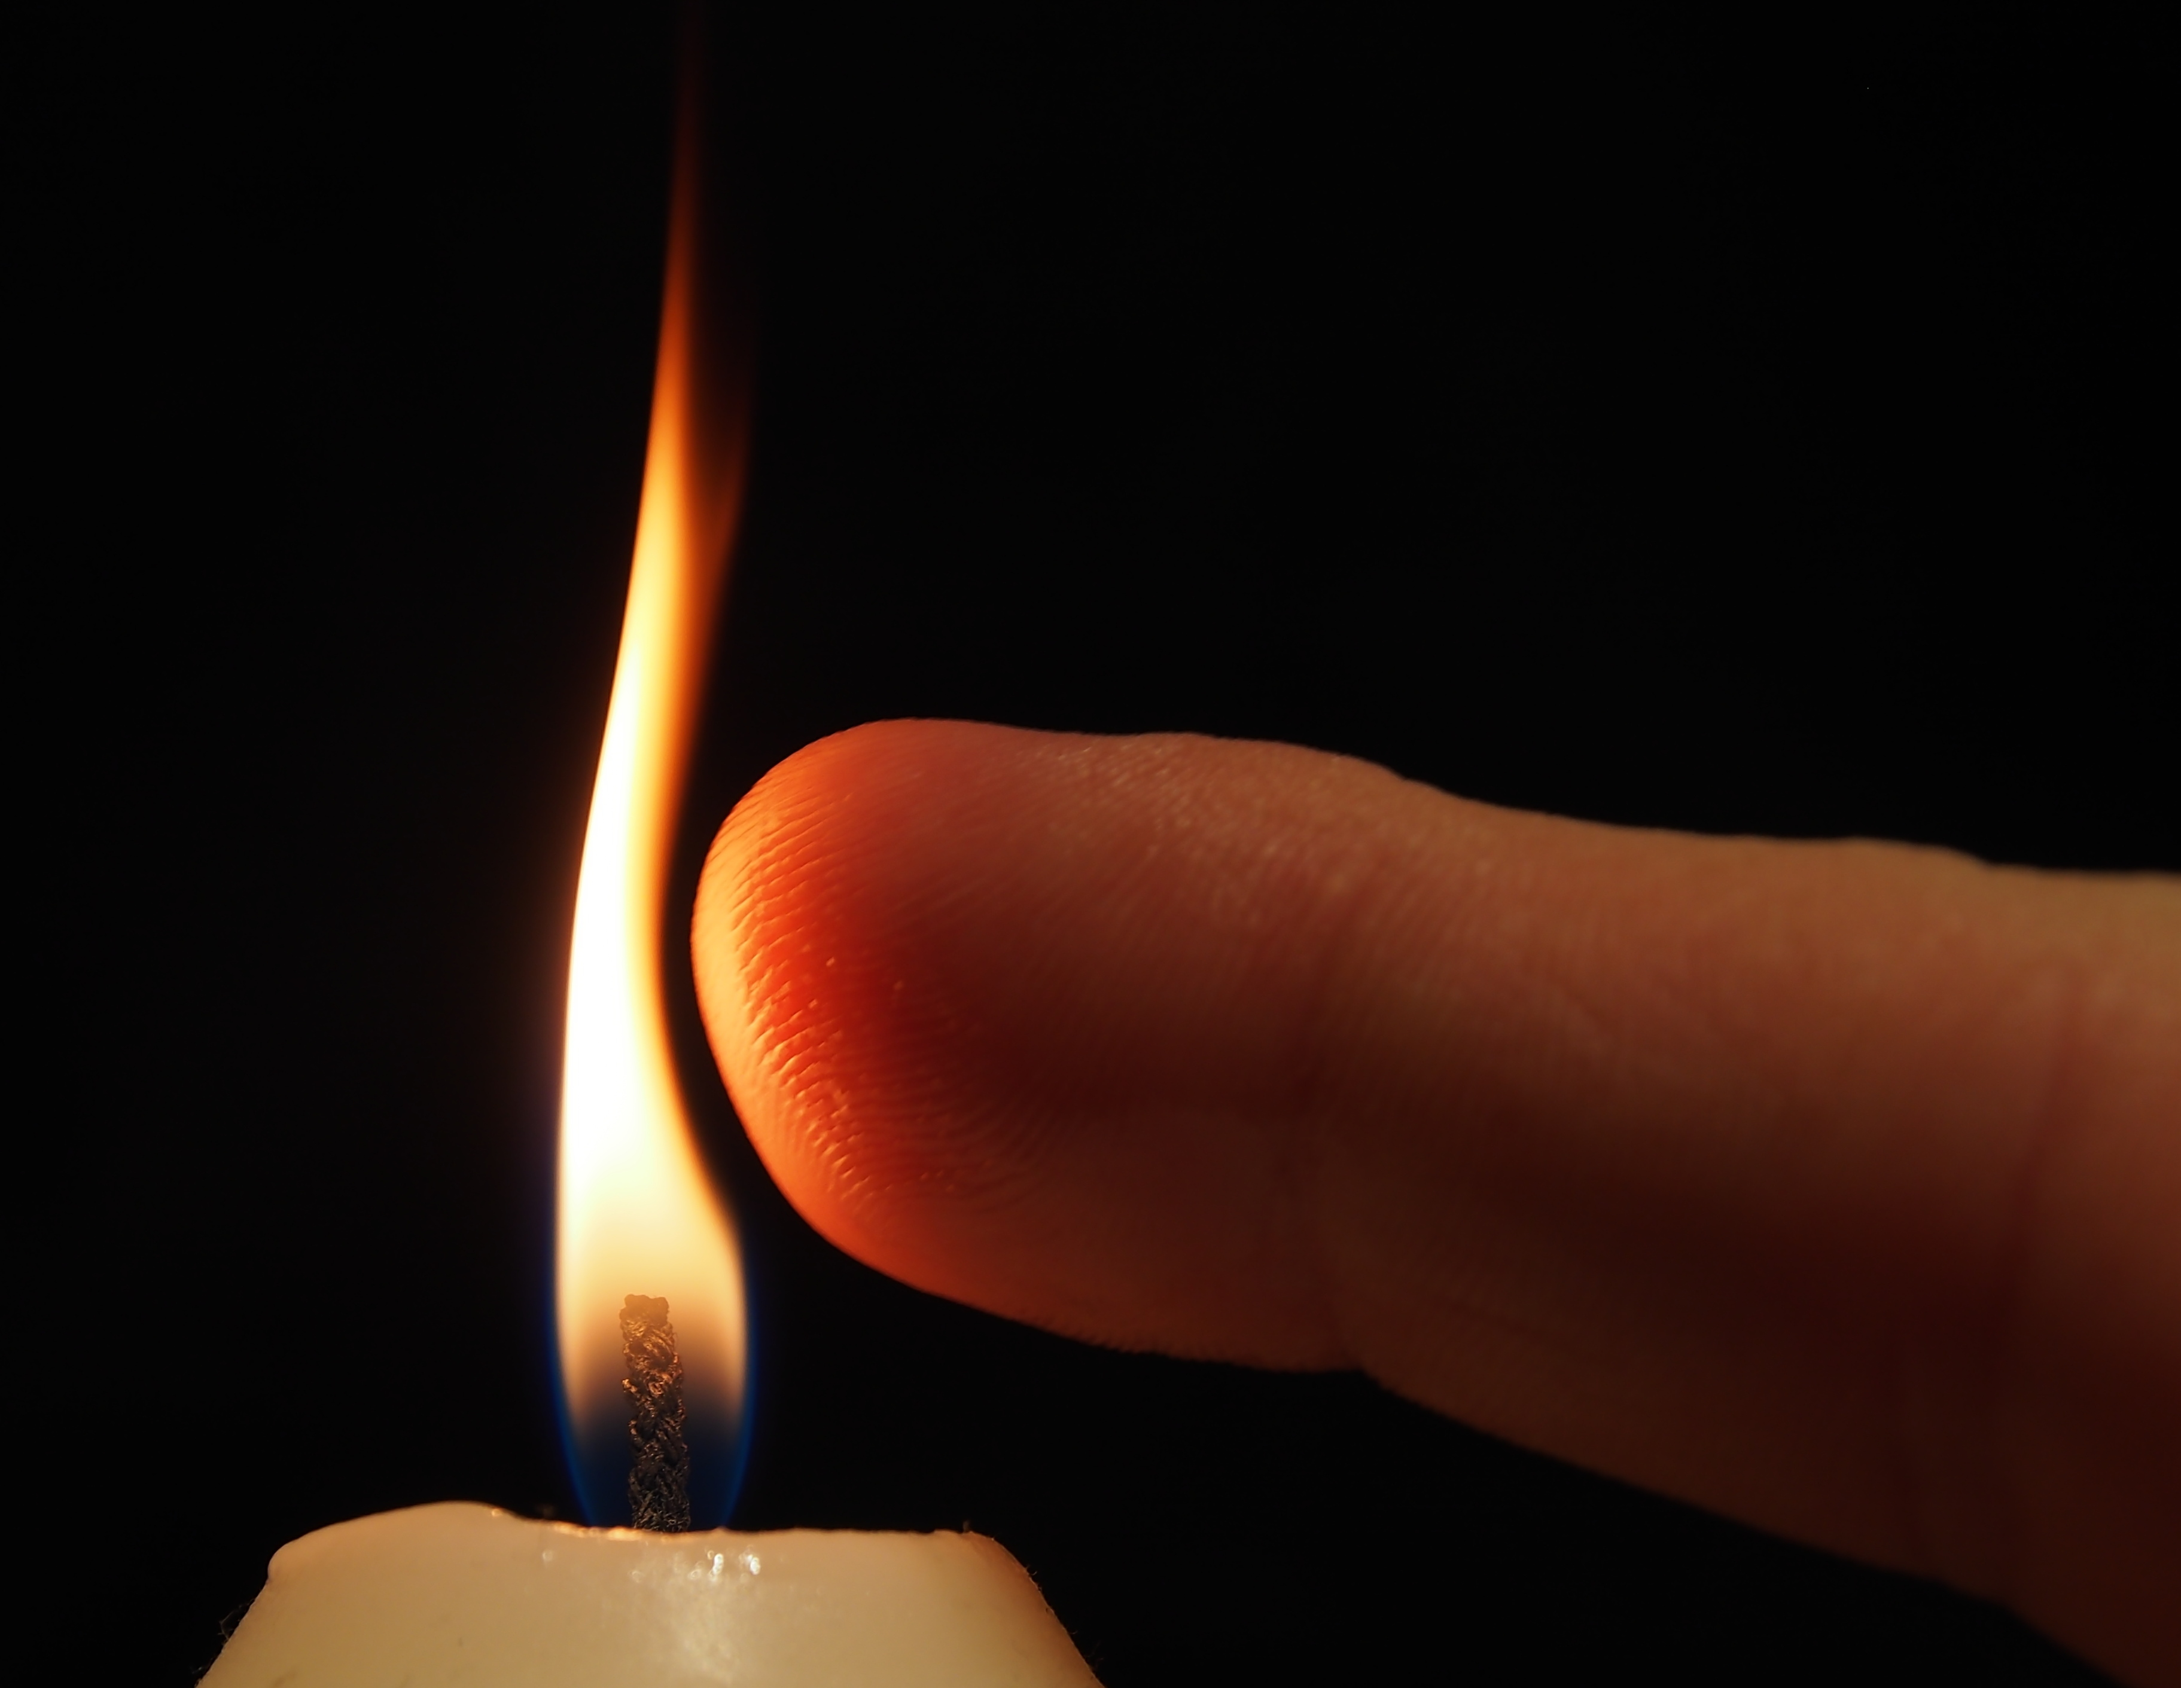
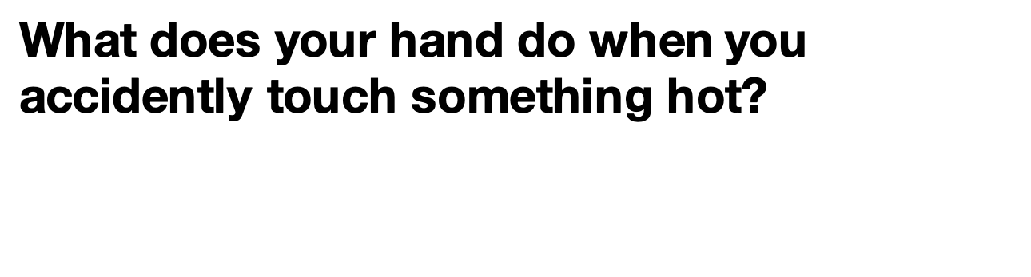
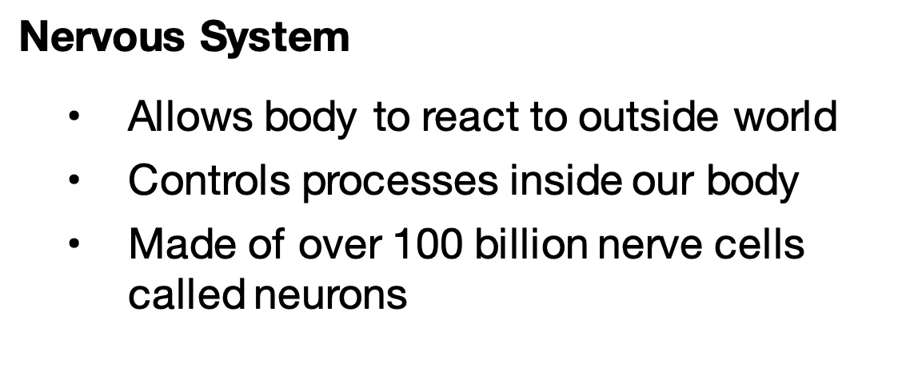
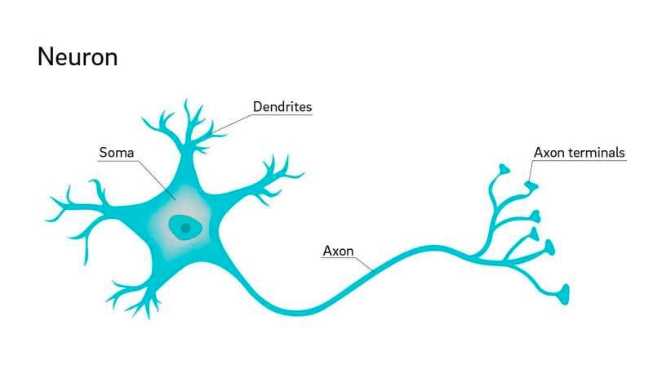
Nervous System
  Allows body to react to outside world
  Controls processes inside our body
  Made of over 100 billion nerve cells called neurons
Notes:
Instructor Notes:
Ask students to act out what their hands do when they accidentally touch something hot. Anticipated responses include yanking hands back, yelping, etc.
Confirm that the instinctual response is to move their hand away quickly. This “instinct” is controlled by the nervous system.
Ask the students how they think signals travel from their hand when they touch a hot stove to their brain. Explain to the students that our nervous system uses electrical and chemical signals to communicate.
Click to display the information about the nervous system. Read or ask a volunteer to read.
Key Talking Point:
The nervous system allows the body to react to the outside world as well as to control processes in the body.

Slide 3
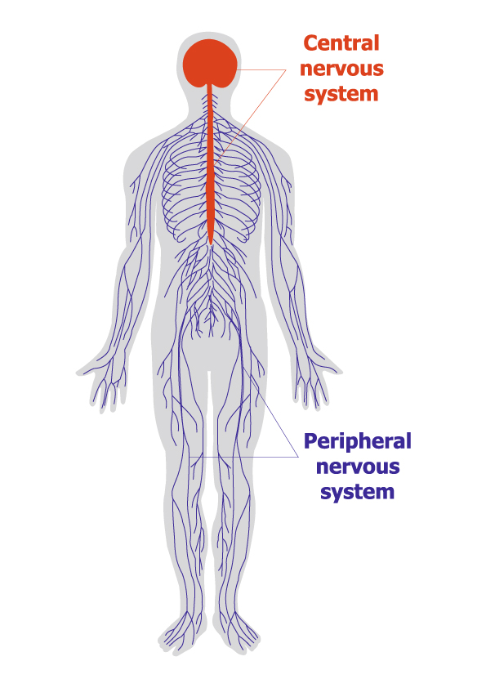

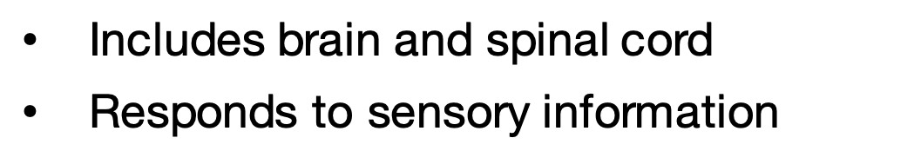

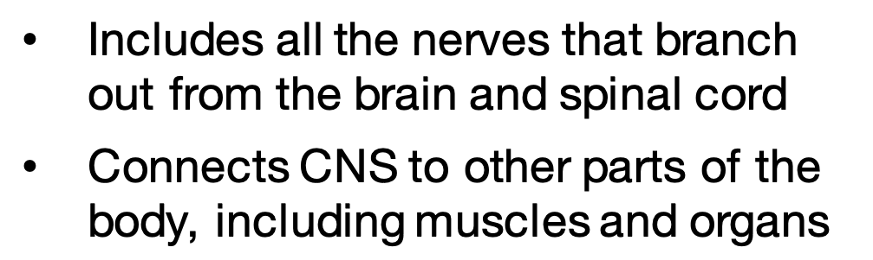
Includes brain and spinal cord
Responds to sensory information
Includes all the nerves that branch out from the brain and spinal cord
Connects CNS to other parts of the body, including muscles and organs
Notes:
Instructor Notes:
The nervous system is made up of two parts– the central nervous system (CNS) and the peripheral nervous system (PNS).
Click to show students that the CNS includes the brain and the spinal cord and responds to sensory information. Click again to show that the PNS includes all the nerves that branch out from the CNS, connecting it to the other parts of the body like muscles and organs.
Key Talking Points:
The nervous system is made up of the central nervous system and the peripheral nervous system.
The central nervous system includes the brain and spinal cord.
The peripheral nervous system includes all other nerves and connects the CNS to the rest of the body.

Slide 4



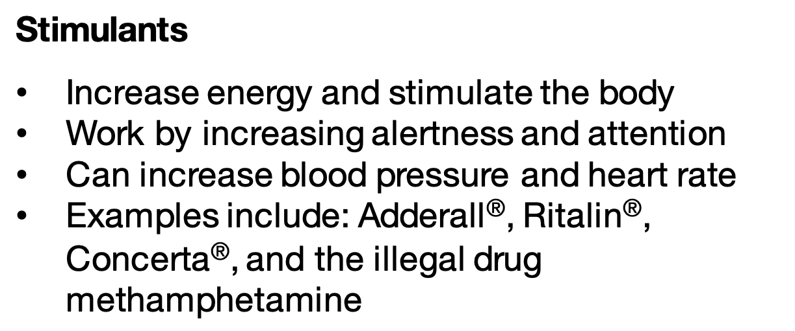

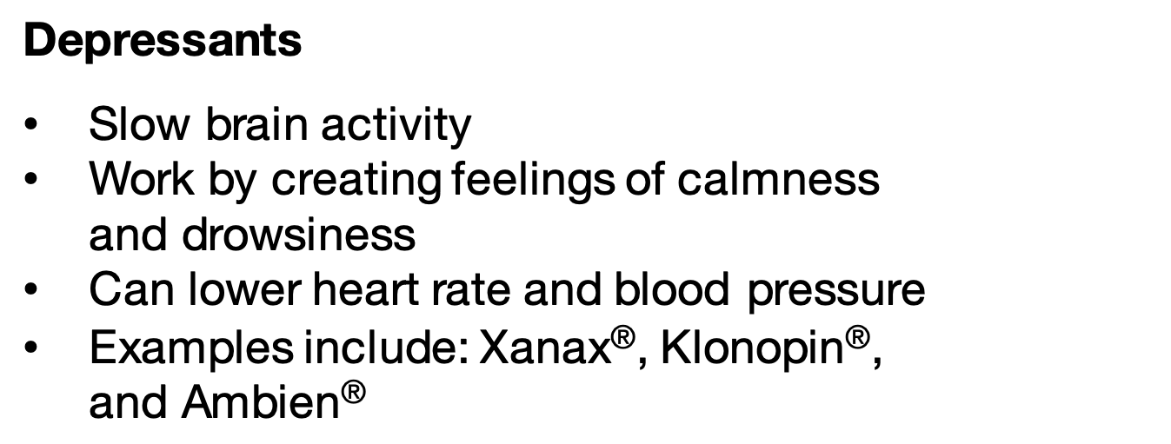


Stimulants
Increase energy and stimulate the body
Work by increasing alertness and attention
Can increase blood pressure and heart rate
Examples include: Adderall®, Ritalin®, Concerta®, and the illegal drug methamphetamine
Depressants
Slow brain activity
Work by creating feelings of calmness
and drowsiness
Can lower heart rate and blood pressure
Examples include: Xanax®, Klonopin®, and Ambien®
Notes:
Instructor Notes:
Explain to the students that different drugs have different effects on the brain and nervous system.
Explain that the students may recognize some of the names of the medications we will discuss today. It's important to remember that when taking these medications as prescribed by a doctor for a legitimate medical purpose, these medications can be very effective and safe. However, when misused, these medications can have harmful effects.
Have the students look at the picture then ask what the difference is between the person on the left and the right.
Click and explain that prescription stimulants are generally used to treat attention-deficit hyperactivity disorder (ADHD) and narcolepsy—uncontrollable episodes of deep sleep. They work by increasing alertness, attention, and energy. Some examples you may have heard of include prescription medications like Adderall®, Ritalin®, Concerta® and the illegal drug, methamphetamine (meth). Side effects of these medications may include: anxiety, trouble sleeping, reduced appetite, and increased heart rate. Misusing prescription stimulants can cause psychosis, paranoia, heart attack, or stroke.
Click again and explain that depressants have the opposite effects of stimulants. Depressants are medications that include sedatives, tranquilizers, and hypnotics. Some examples you may have heard of include prescription medications like Xanax®, Klonopin®, or Ambien® that work by slowing brain activity, making them useful for treating anxiety, panic, and sleep disorders. Side effects of these medications may include: slurred speech, confusion, dizziness, drowsiness, and slowed breathing. Most are prescribed for a short period of time and are used responsibly by the patient. Combining these types of medications with other drugs, like opioids, or with alcohol dramatically increases the risk for serious and deadly consequences.
Key Talking Points:
-Prescription stimulants work by increasing alertness, attention, and energy.
-Depressants are medications that slow brain activity, making them useful for treating anxiety, panic, and sleep disorders.
-Stimulants and depressants have legitimate medical purposes when used appropriately but can be very dangerous when misused or abused.

Slide 5
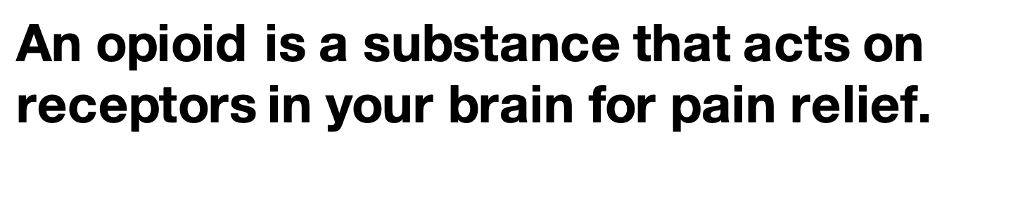
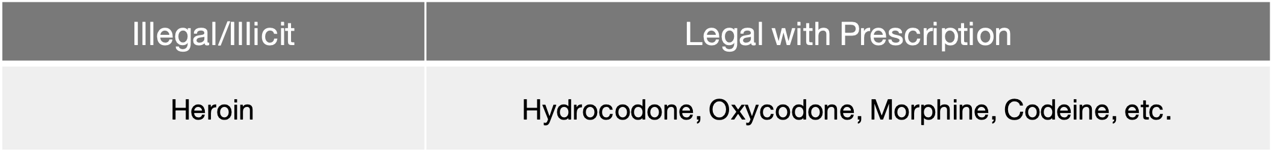
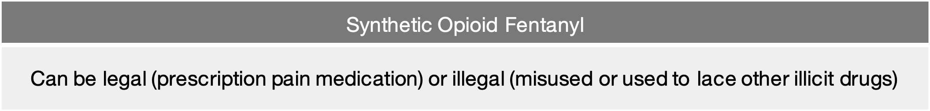
Illegal/Illicit | Legal with Prescription
Heroin | Hydrocodone, Oxycodone, Morphine, Codeine, etc.
Synthetic Opioid Fentanyl
Can be legal (prescription pain medication) or illegal (misused or used to lace other illicit drugs)
Notes:
Instructor notes:
Inform students that opioids are substances that act on receptors in your brain for pain relief.
Click to explain to them that the legal opioids are only available with a prescription (i.e., Hydrocodone, Oxycodone, Morphine and Codeine). You may recognize their brand names as Vicodin®, OxyContin®, or Percocet®. Other opioids, like heroin, are illegal/illicit.
Click again to discuss the opioid fentanyl, which is a powerful synthetic opioid that is similar to morphine but is 50-100 times more potent. It is a prescription drug used to treat patients with severe pain. More recently fentanyl is showing up in illegal street drugs, like heroin or fake prescription pain pills.
Ask for 1-2 volunteers to offer examples of any other medications they’re familiar with to treat pain that are not opioids. Reinforce to students that there are many common over the counter (OTC) pain medications available. Explain that nonsteroidal anti-inflammatory drugs, referred to as NSAIDs (like aspirin or ibuprofen/Motrin®), help reduce pain and swelling from ailments such as minor sports injuries, headaches, and arthritis. Acetaminophen (Tylenol®) is often used to treat minor aches and pains and reduce fevers. Emphasize that an OTC medication, like ibuprofen or acetaminophen, may be sufficient to control mild or short-term pain.
Key Talking Points:
-Opioids can be both legal (e.g. prescription opioids) and illegal (e.g. heroin).
-Fentanyl is an FDA approved opioid pain medication to treat severe pain, but is often dangerously used to lace illicit/illegal drugs.
-NSAIDs (like aspirin or ibuprofen) help reduce minor pain and swelling.
-Acetaminophen is often used to treat minor aches and pains and reduce fevers.

Slide 6
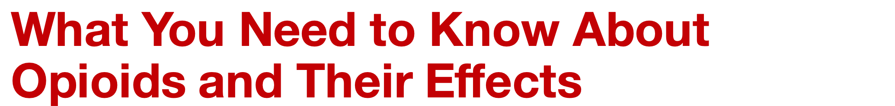

Notes:
Instructor Notes:
Tell students that opioids have many effects on the brain and body. Ask students to draw a T-chart on a piece of paper and title it with “Brain” and “Body.” As students watch the upcoming video, they should capture how opioids impact each and write that in the appropriate column.
Click to play the video.
After the video, invite students to share some facts they learned from the video. Write facts on the board for reference throughout the session. Use the Age Appropriate Information T-Chart answer key as a guide.

Slide 7
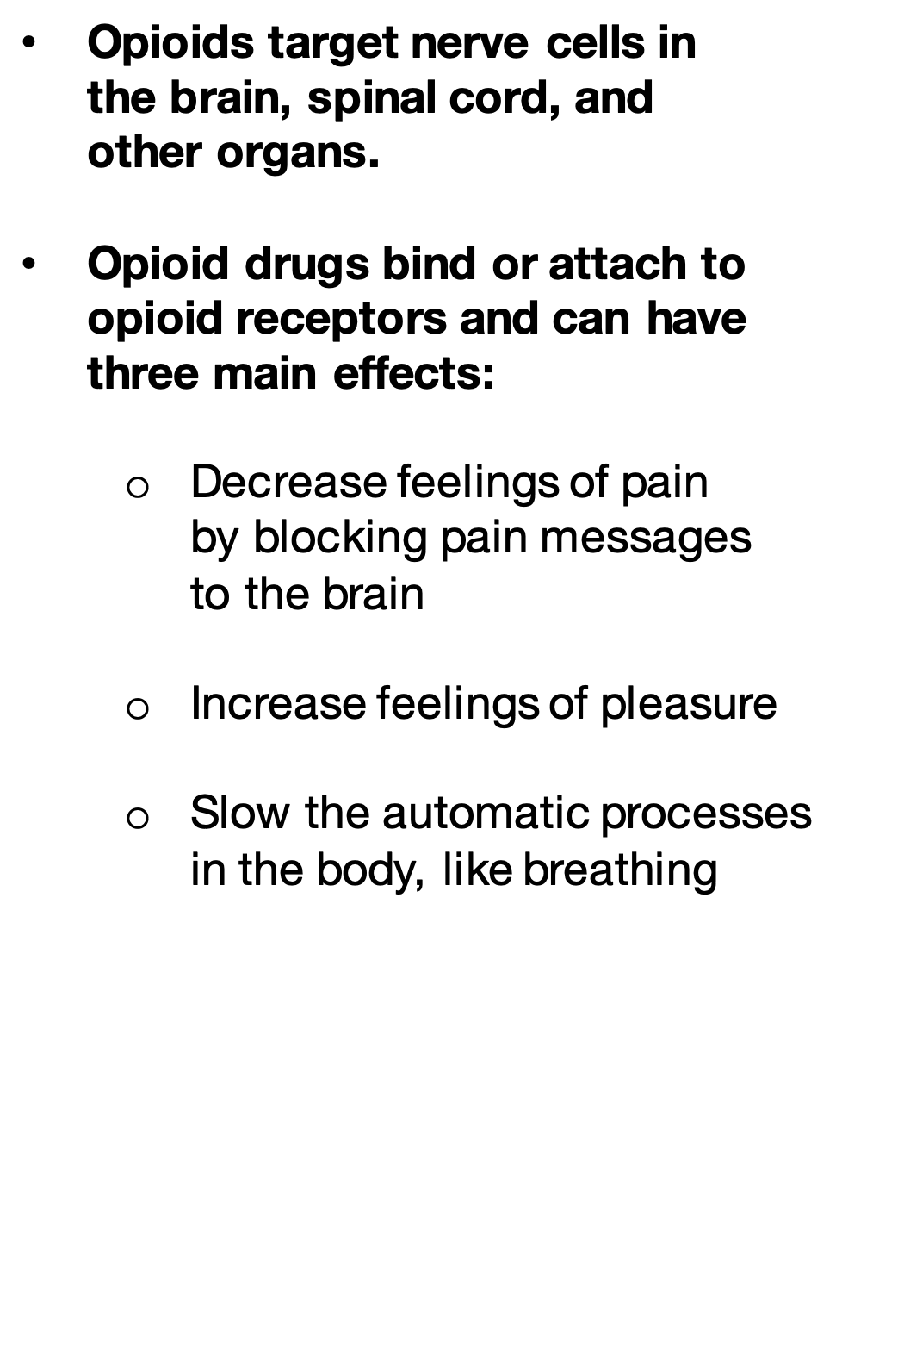
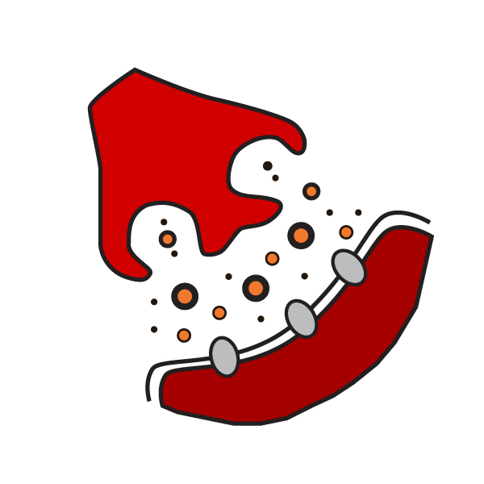



Notes:
Instructor notes:
Opioids mainly target cells in the brain, spinal cord, and other organs in the body that involve pain and/or pleasure. This is because they block pain messages and act on the reward center of the brain. They do this by attaching to the opioid receptors in the brain and spinal cord to block the transmission of pain messages to the brain. This is why doctors prescribe opioids to patients.
Opioids bind to opioid receptors in the brain and can produce three main effects: 1) decreased feelings of pain, 2) increased feelings of pleasure, and 3) slowed body processes that are usually automatic, like breathing.
Key Talking Points:
-Opioids bind to receptors in the brain and target nerve cells that experience pain and pleasure.
-Opioids can decrease pain, increase pleasure, and affect automatic body processes.

Slide 8
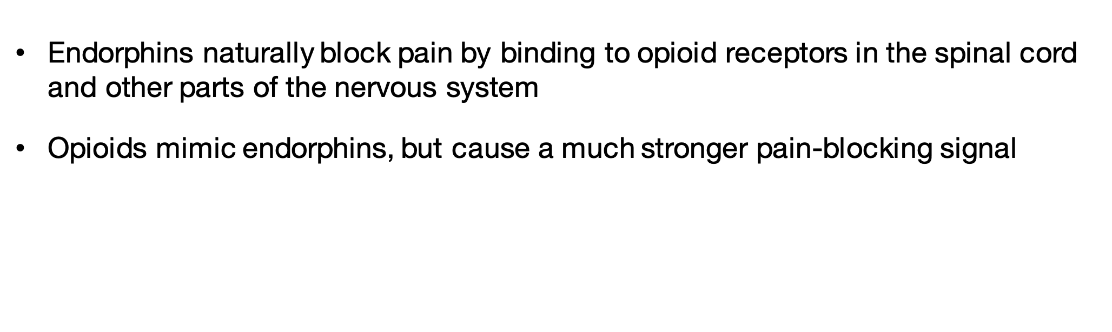
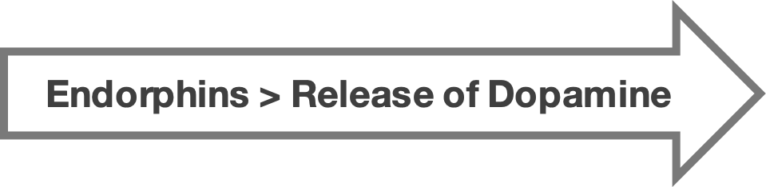
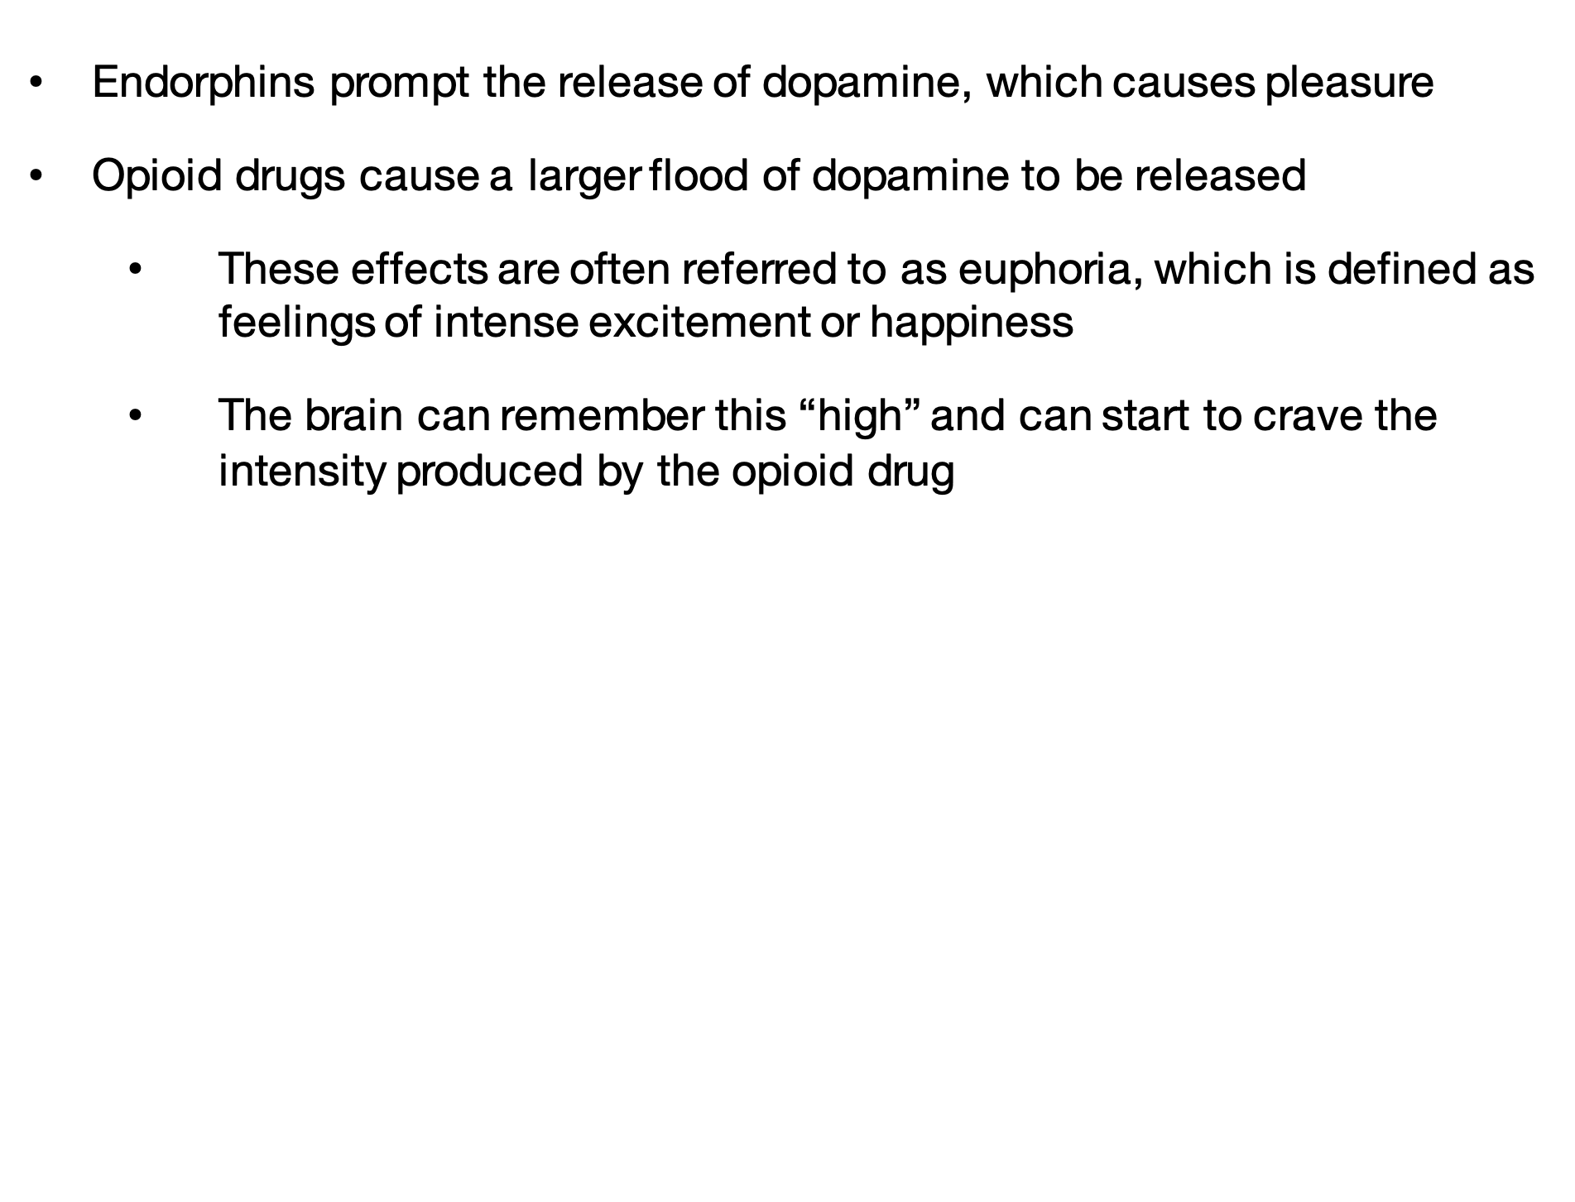
Endorphins naturally block pain by binding to opioid receptors in the spinal cord and other parts of the nervous system
Opioids mimic endorphins, but cause a much stronger pain-blocking signal
Endorphins > Release of Dopamine
Endorphins prompt the release of dopamine, which causes pleasure
Opioid drugs cause a larger flood of dopamine to be released
  These effects are often referred to as euphoria, which is defined as feelings of intense excitement or happiness
  The brain can remember this “high” and can start to crave the intensity produced by the opioid drug
Notes:
Instructor notes:
Read or ask for a volunteer to read the information about endorphins.
Click to reveal that the presence of endorphins leads to the release of dopamine.
Click again and explain the effects of the release of dopamine, a neurotransmitter that plays a role in pleasure.
Ask 1 or 2 volunteers to share why it might be problematic for the body to crave the intensity produced by opioids over natural dopamine release. Reinforce that this craving is what can lead to misuse, tolerance, dependence, and ultimately substance use disorder, overdose, or death.
Key Talking Points:
-Endorphins are the body's natural pain relievers.
-Opioids mimic endorphins.
-Endorphins prompt the release of dopamine, which produces pleasure.
-Opioid drugs cause a larger flood of dopamine than endorphins do (euphoria=intense feelings of pleasure)
-Misuse of opioids can lead to substance use disorder, overdose, or death.

Slide 9

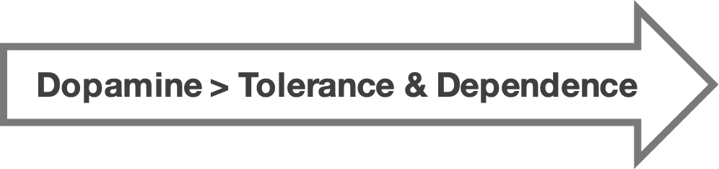
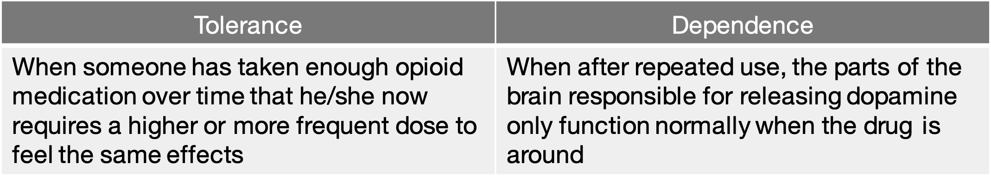
Dopamine > Tolerance & Dependence
Tolerance | Dependence
When someone has taken enough opioid medication over time that he/she now requires a higher or more frequent dose to feel the same effects | When after repeated use, the parts of the brain responsible for releasing dopamine only function normally when the drug is around
Notes:
Instructor notes:
Click to reinforce that the body’s response to dopamine rushes can result in tolerance and dependence.
Click again to review the information in the table. Tolerance is when the body requires higher or more frequent dosages to gain the same effect - like needing more gold stars to feel as happy as you did before. Dependence is when the parts of the brain responsible for releasing dopamine only function normally when the drug is taken.
Key Talking Points:
-Tolerance is when one requires higher or more frequent dosages to experience the same effects of a drug.
-Opioid dependence is when the brain can only release dopamine if the drug is present.
Source: https://www.thetruth.com/o/articles/opioid-addiction

Slide 10
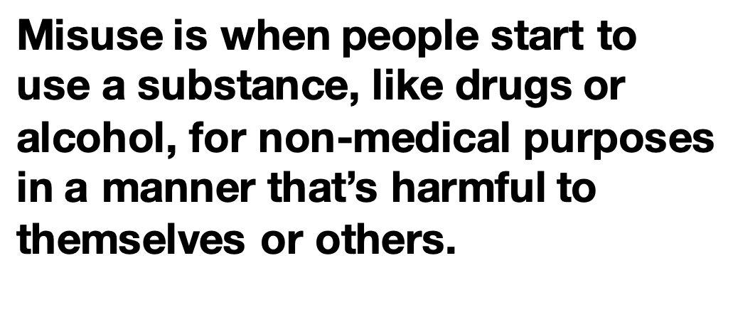
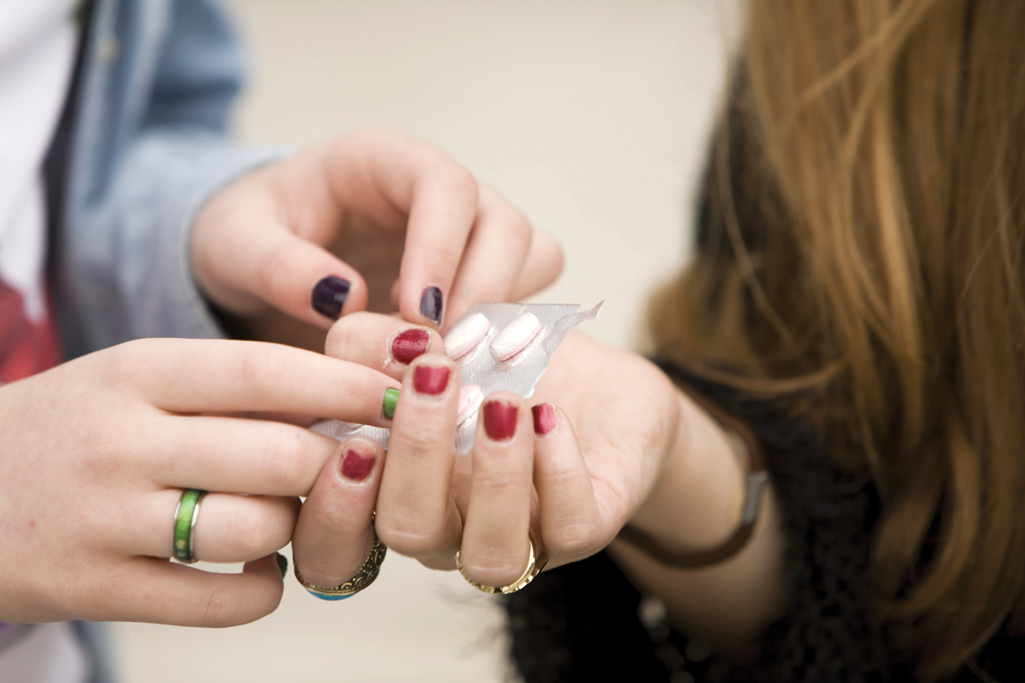
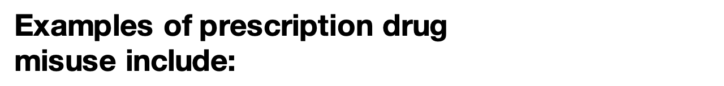




Examples of prescription drug
misuse include:
Not following the instructions
from your doctor
Taking more of a medication
than is prescribed
Taking medication that belongs
to someone else
Taking a medication to feel euphoric
(i.e., to “get high”)
Notes:
Instructor notes:
Substance misuse is when people start to use a substance, like drugs or alcohol, for non-medical purposes in a manner that’s harmful to themselves or others.
Click to reveal the ways in which a person can misuse prescription drugs. Ask 2-3 volunteers to share what they think would happen to themselves or someone they know if they misused a prescription medication. Anticipated responses might include: it can lead to substance use disorder or addiction, it can cause overdose or death, etc.
Reinforce that not all opioids contain the same potency or strength, and only a doctor can prescribe the correct form. Therefore, the dosage prescribed for someone else can be wrong for you, can be risky, and ultimately can lead to overdose or death. It is also important that students understand that buying drugs anywhere other than a pharmacy can run the risk of being laced with ultra-potent synthetic drugs, such as Fentanyl or Carfentanyl.
Key Talking Points:
-When a drug is used in a manner other than how it was prescribed, it is referred to as misuse.

Slide 11

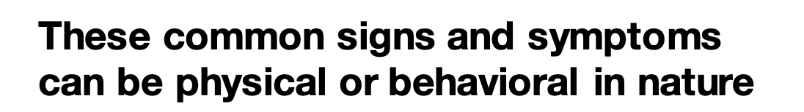
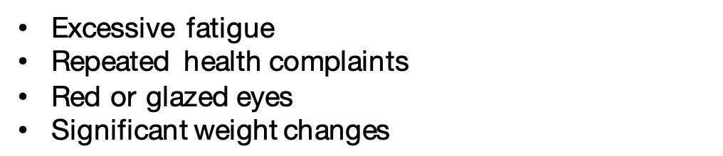

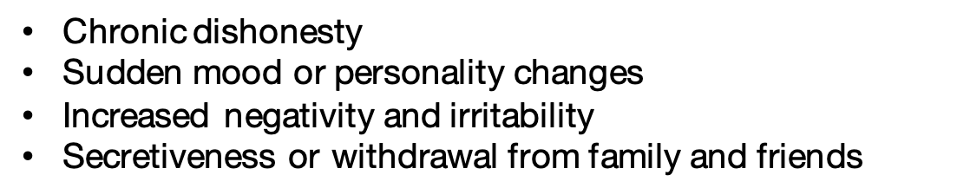

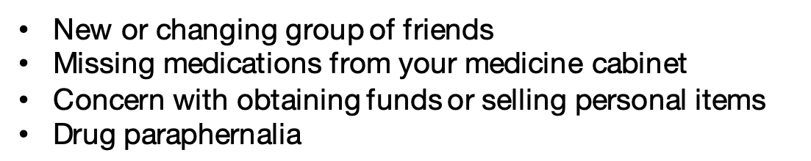

Excessive fatigue
Repeated health complaints
Red or glazed eyes
Significant weight changes
Physical
Chronic dishonesty
Sudden mood or personality changes
Increased negativity and irritability
Secretiveness or withdrawal from family and friends
Behavioral
New or changing group of friends
Missing medications from your medicine cabinet
Concern with obtaining funds or selling personal items
Drug paraphernalia
Other Signs
& Symptoms
Notes:
Instructor notes:
Now that students have explored opioids’ effects on the body and substance misuse, they will learn other common signs and symptoms of an individual misusing substances, like opioids.
Click to reveal some of the physical signs/symptoms of substance misuse.
Click again and explain the behavioral signs/symptoms of substance misuse.
Lastly, click to reveal other common signs and symptoms of misusing opioids.
Key Talking Points:
-Common signs and symptoms of substance misuse can be physical, behavioral, or be displayed in new habits or preoccupations.

Slide 12
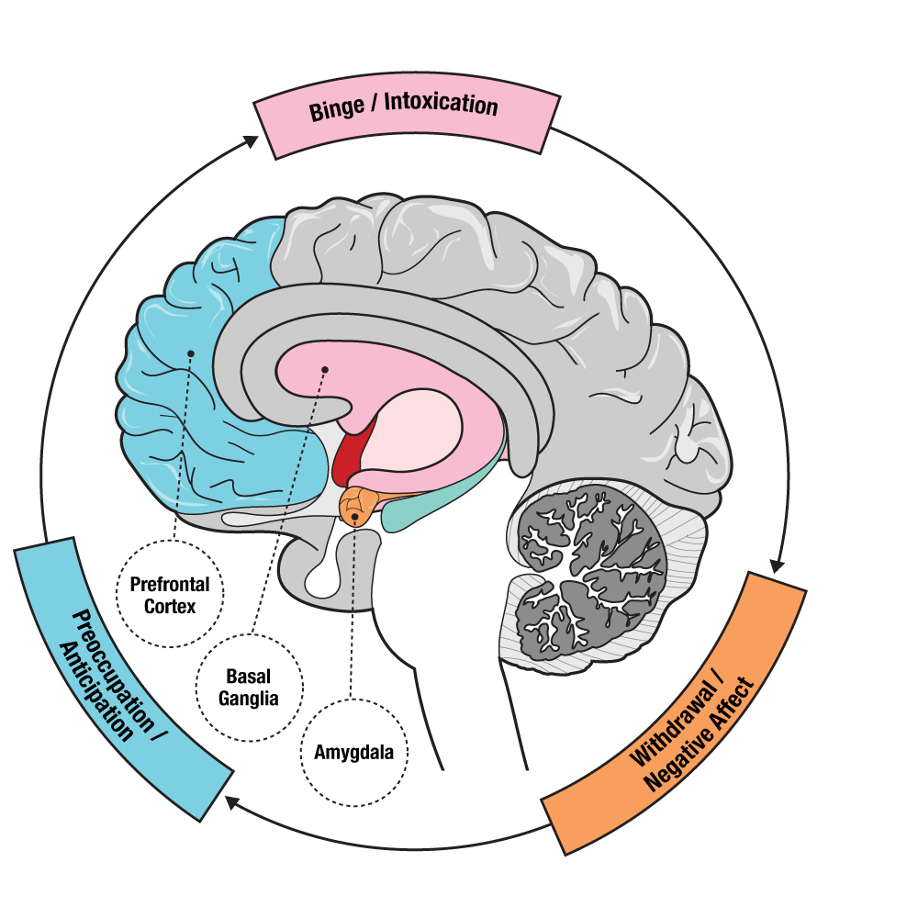
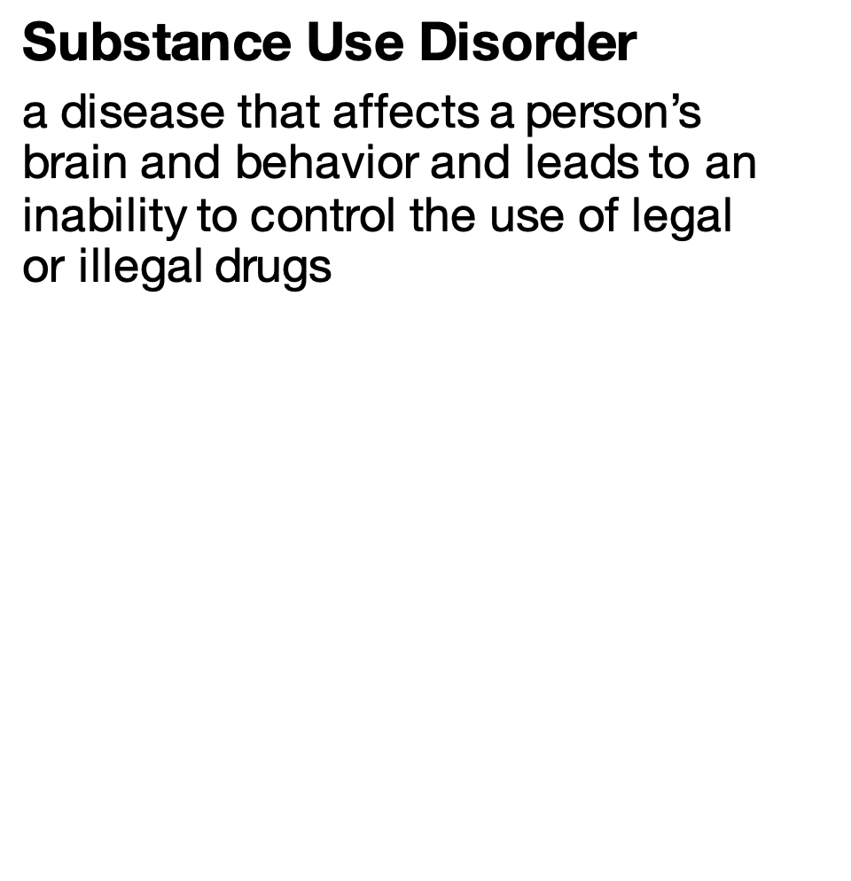



Notes:
Instructor Notes:
Define substance use disorder (SUD) as a disease that affects a person’s brain and behavior and leads to an inability to control the use of legal or illegal drugs. Explain this is a disease with repeated actions that will cause the nerve cells to communicate differently—a cycle that involves binging on drugs, becoming intoxicated, withdrawal, and the preoccupation with using more drugs.
Click to reveal the image of the brain. Explain that SUD makes the brain want to recreate the feelings it experiences when the drug is present– increased feelings of pleasure and decreased feelings of pain. Regardless of the consequences, a person with substance use disorder will continue to seek a drug. One has to take more of a substance to obtain the same dopamine "high" because his/her brain has adapted. Reinforce that this is known as tolerance. As a result, they will increase the amount of the substance they take in an effort to achieve the high they are used to.
When they are not taking the substance, people will experience withdrawal, causing them to feel severe physical and emotional distress. Eventually, the person’s brain can no longer function as it should without the presence of the substance. They will become extremely preoccupied or obsessed with thinking about how they will get their next fix so that they can avoid withdrawal and just be able to function.
These changes in the brain remain even after substance misuse stops and explain why it can be so difficult for someone to stop using and for relapse to occur. However, keep in mind, that with the right support, treatment, and care, recovery is possible!
Click to reveal the image of the stigma word cloud. Reinforce to students that addiction is a brain disease NOT a moral failing. It's important that they recognize the words we use matter. Instead of using stigmatizing terms, like addict or junkie, use person-first language like “a person with a substance use disorder". No matter the situation, no one likes to feel judged or devalued. In order to encourage people to reach out for help, it's important to reduce the stigma surrounding their situation.
Key Talking Points:
-Substance use disorder is a disease that affects a person’s brain and behavior.
-This disease creates a cycle, often referred to as the “cycle of addiction.”
-The words we use matter. Instead of using a stigmatizing term, like addict or junkie, use person-first language like “a person with a substance use disorder.”

Slide 13
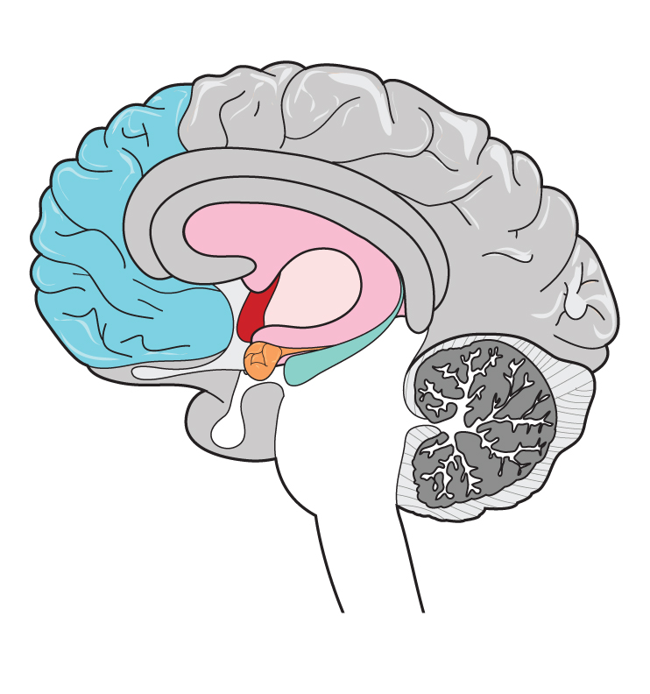
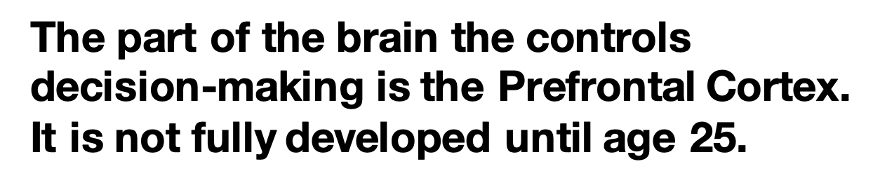
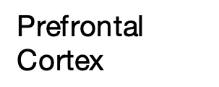
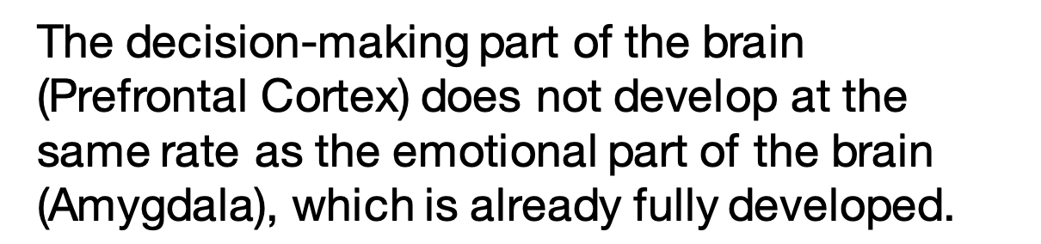

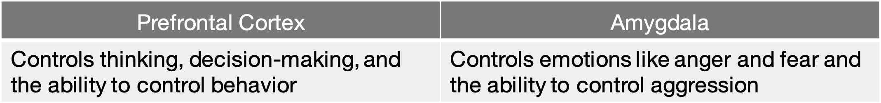
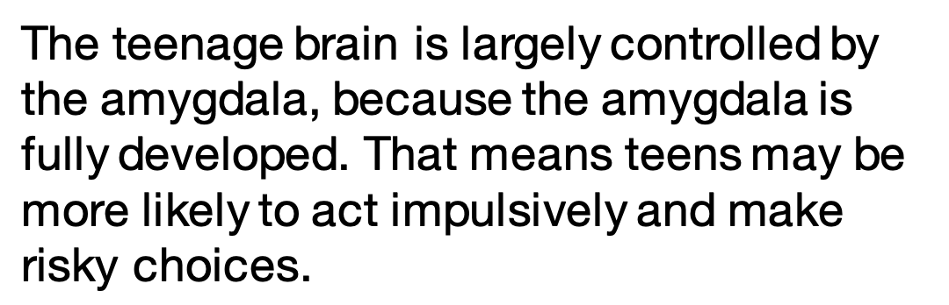
The part of the brain the controls decision-making is the Prefrontal Cortex. It is not fully developed until age 25.
Prefrontal
Cortex
      The decision-making part of the brain (Prefrontal Cortex) does not develop at the same rate as the emotional part of the brain (Amygdala), which is already fully developed.
Amygdala
Prefrontal Cortex | Amygdala
Controls thinking, decision-making, and the ability to control behavior | Controls emotions like anger and fear and the ability to control aggression
The teenage brain is largely controlled by the amygdala, because the amygdala is fully developed. That means teens may be more likely to act impulsively and make risky choices.
Notes:
Instructor Notes:
Ask the students at what age they think the teenage brain is fully developed. Allow for several responses, then click to reveal that the rational part of the teen brain responsible for decision-making is not fully developed until age 25 or later. The decision-making and emotional parts of the brain do not always develop at the same rate.
Click again to reveal to students the names of these two parts of the brain. The prefrontal cortex controls decision-making and behavior. The amygdala controls emotions and aggression.
Highlight that the teen brain mostly uses the amygdala since the rational, decision-making prefrontal cortex is not fully developed. This makes it difficult to control emotions, often results in risky, impulsive behavior, and the lack of awareness of consequences leads to poor planning and judgement. This also explains the desire for teenagers to participate in high-excitement/low-effort activities such as experimenting with drugs.
Click a final time to reinforce that teens are more likely to make risky and impulsive choices because their brains are largely controlled by the amygdala.
Key Talking Points
-The rational, decision-making prefrontal cortex of the teen brain is not fully developed until age 25 or later.
-The amygdala controls emotion and aggression.
-Teenagers process information with mainly the amygdala since the prefrontal cortex is not fully developed. Result: difficult to control emotions, risky, impulsive behavior, lack of awareness of consequences, poor planning and judgement, leading to an increased risk of addiction.
- Click a final time to reinforce that teens are more likely to make risky and impulsive choices because their brains are largely controlled by the amygdala.

Slide 14
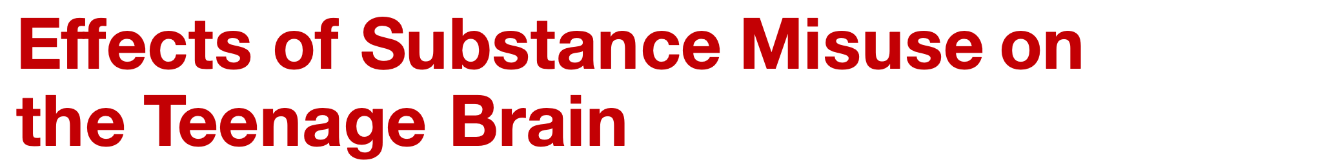
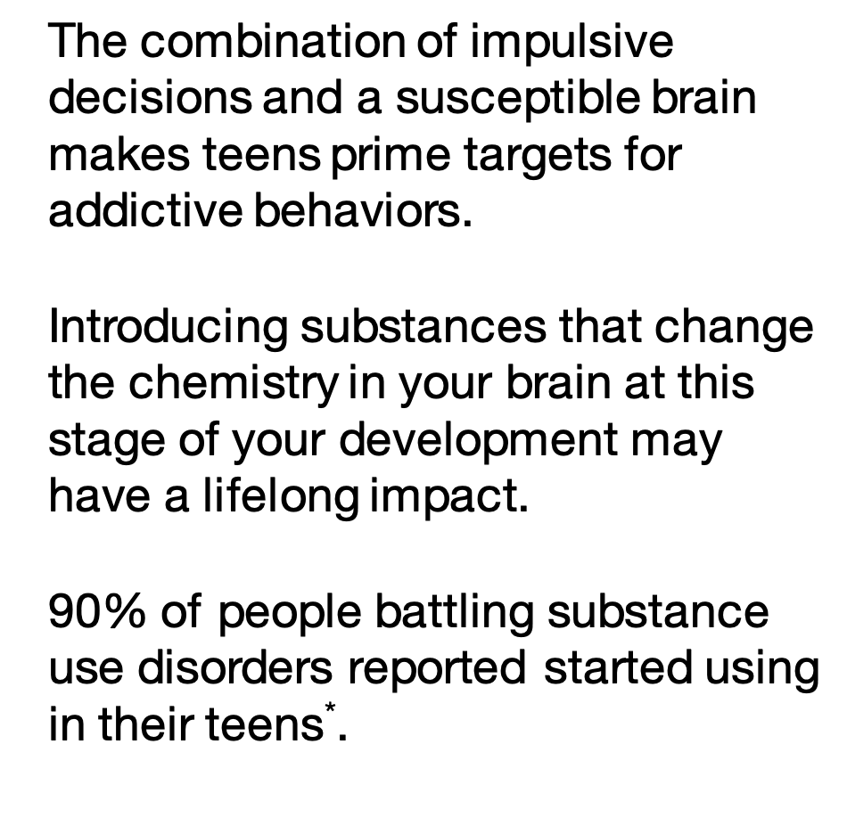

Notes:
Instructor notes:
Use this slide to make the connection with students that the combination of increased impulsivity and a susceptible brain puts them at increased risk for addictive behaviors.
Reinforce that introducing substances that change the chemistry of their brains while their brains are still developing can cause lifelong effects.
The earlier a person begins misusing a substance, the greater risk they are at for substance use disorder, overdose, or death. Inform students that 90% of those suffering from SUD report starting use during their teens*.
Key Talking Points:
-The combination of impulsive decisions and a susceptible brain makes teens prime targets for addictive behaviors.
-Introducing substances that change the chemistry of the brain at this stage of development may have lifelong impact.
*https://www.centeronaddiction.org/addiction-research/reports/adolescent-substance-use-america%E2%80%99s-1-public-health-problem

Slide 15


Notes:
Instructor Notes:
Click to play the video featuring NFL star Allen Robinson.
Ask a student volunteer to explain what “human resources” are. If not provided by volunteer, explain that human resources like a parent, teacher, coach, or other trusted adult can be the first resource they consult, both to safely use prescription opioids and for help if they or someone they know is struggling with substance misuse or substance use disorder.
Reinforce that Robinson’s healthy decisions in life and reliance on human resources like his mother helped him achieve his dreams.
Direct students to turn to another student near them and identify a person whom they could rely on as a human resource as they try to be a star in life, like Allen Robinson.
Key Talking Points:
-Opioid misuse is illegal and can negatively affect your health and future.
-If you know someone who is misusing drugs, be a friend and support them to get help.
-“Human Resources” are important resources as well. These can include parents, teachers, doctors, coaches, etc.
- Making healthy decision can help you achieve your dreams and goals.

Slide 16

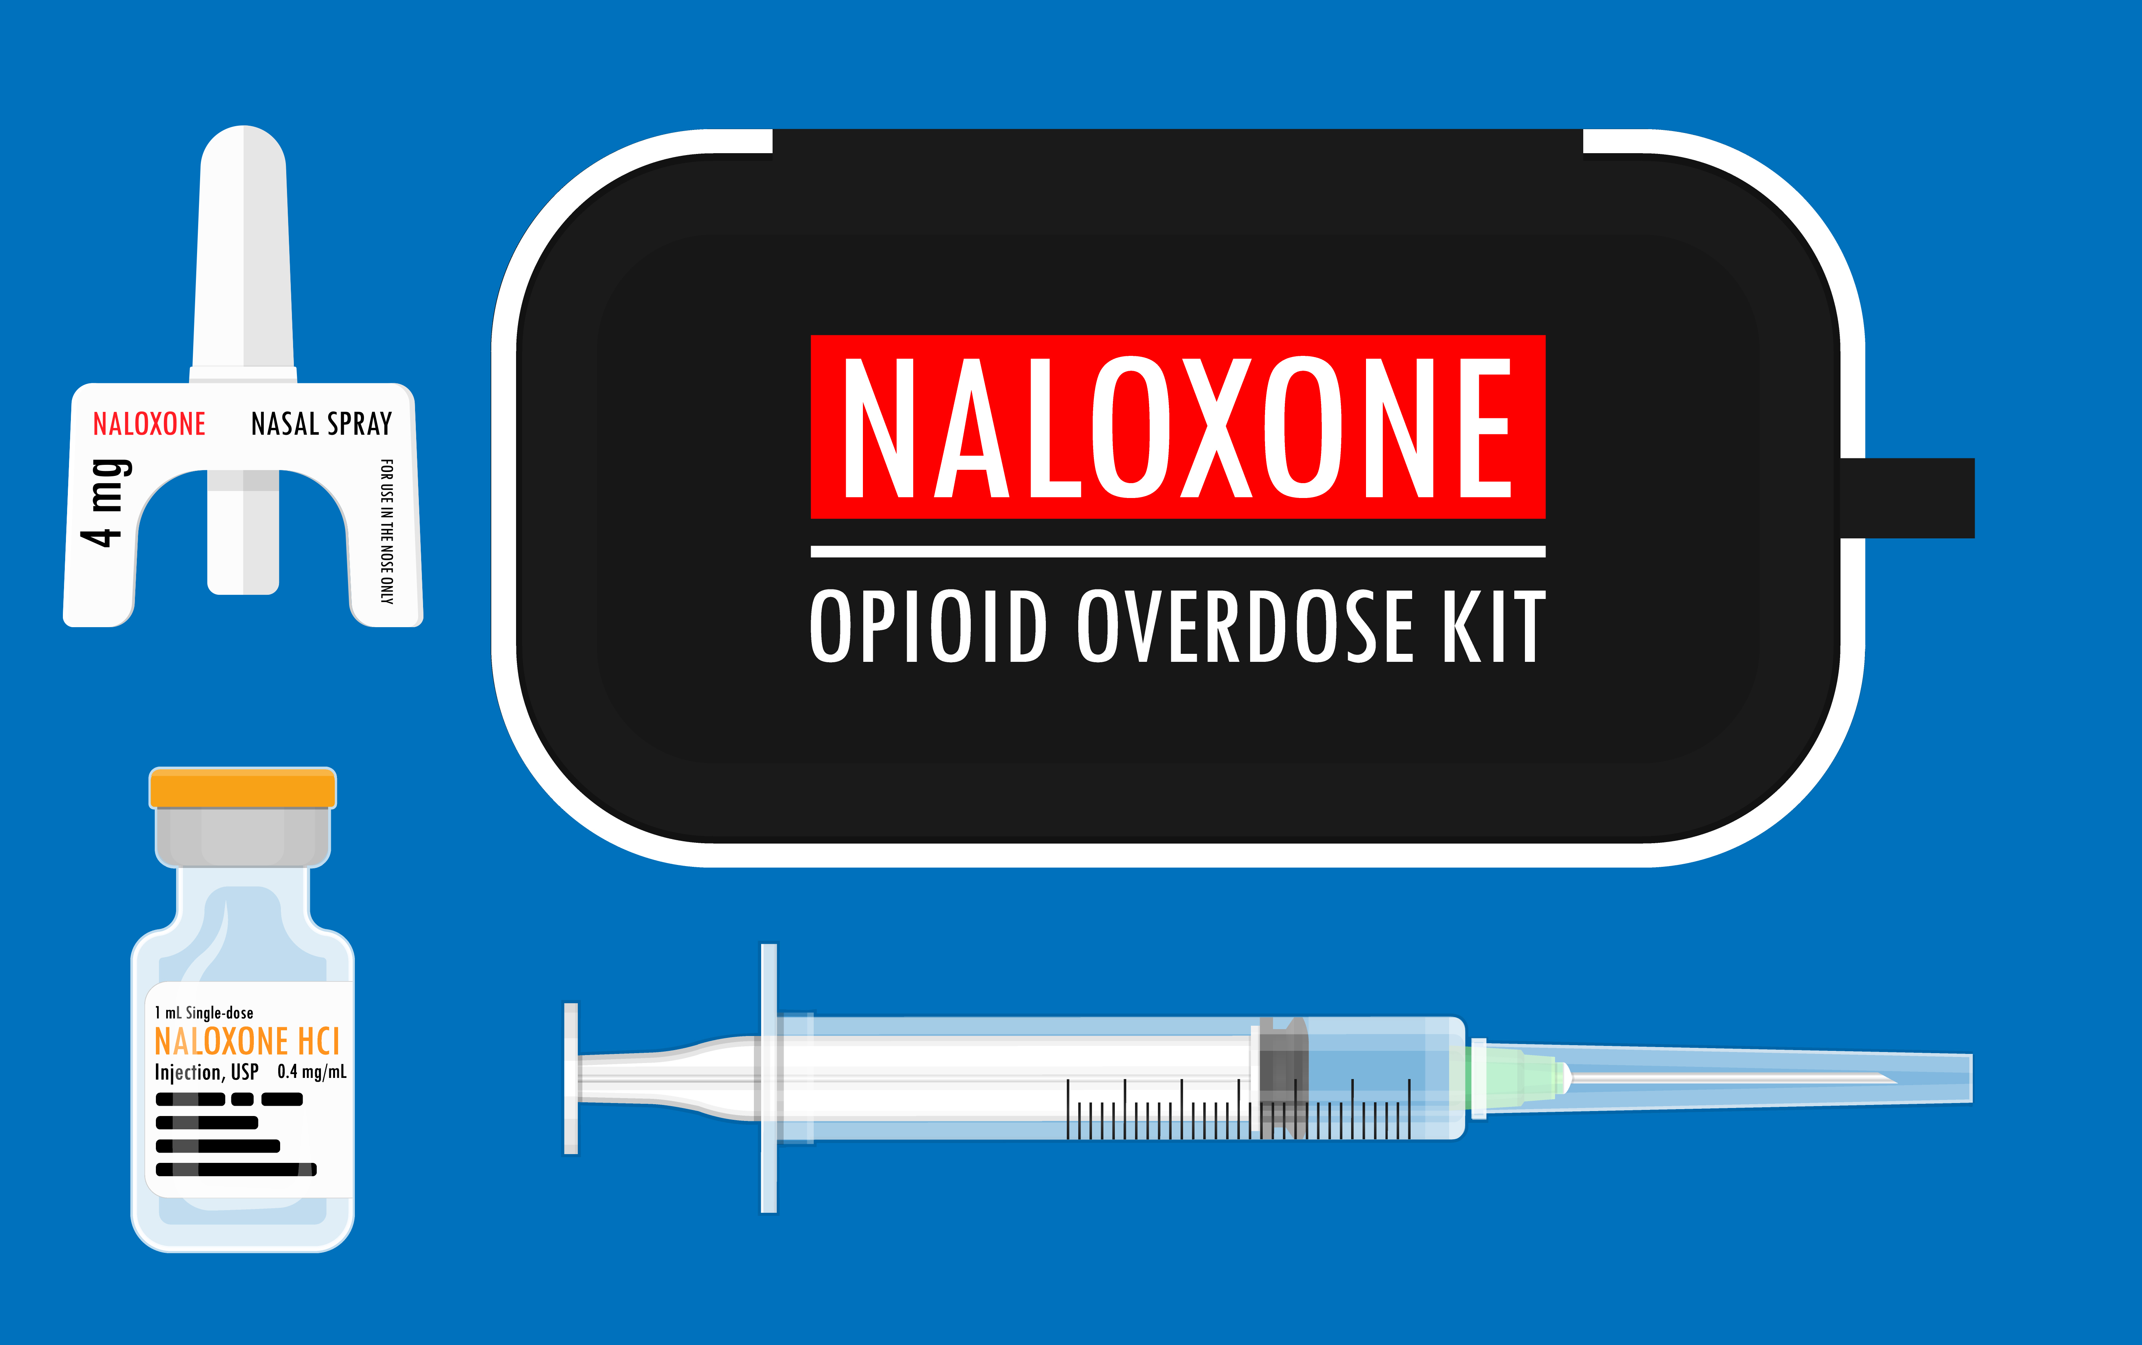
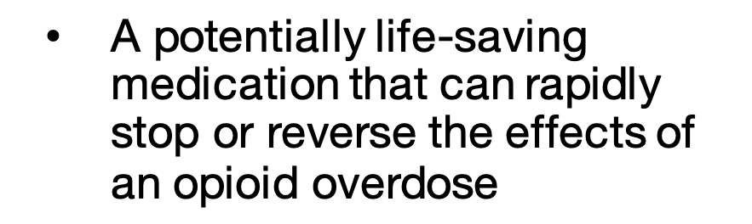
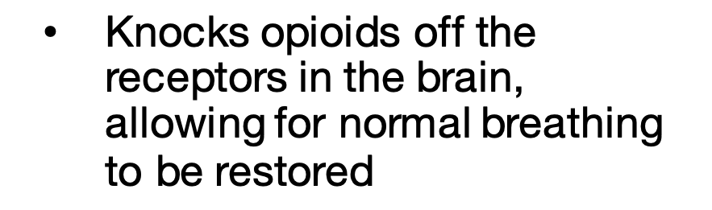
A potentially life-saving medication that can rapidly stop or reverse the effects of an opioid overdose
Knocks opioids off the receptors in the brain, allowing for normal breathing to be restored
Notes:
Instructor Notes:
Naloxone, also known by the brand name Narcan®, is a potentially life-saving medication that can rapidly stop or reverse the effects of an opioid overdose.
Click to reveal that Naloxone works by knocking opioids off the receptors in the brain, allowing for normal breathing to be restored. Naloxone is available at many pharmacies nationwide, available to patients without an individual prescription from their doctor, and oftentimes schools have it on hand in case of an emergency.
Reinforce that they should always call 911 if they suspect someone is experiencing an overdose.
Explain that in most states there are laws (Good Samaritan Laws) that protect people who call 911 to get help for a friend. Even if you've also been drinking or using drugs, you should always call 911 for help and never leave a friend alone.
Key Talking Points:
-Naloxone can rapidly stop or reverse the effects of an opioid overdose.
-If you find a person unresponsive, not breathing, or struggling to breath, you should always call 911.
-Good Samaritan Laws protect people who call 911 to get help for a friend, even if they have also been misusing substances.
NOTE: This content is for educational purposes only and is not intended to provide medical advice. Refer to applicable school, district and medical policies and the instructions of a qualified physician when determining how and when to administer Naloxone or any other medication.

Slide 17
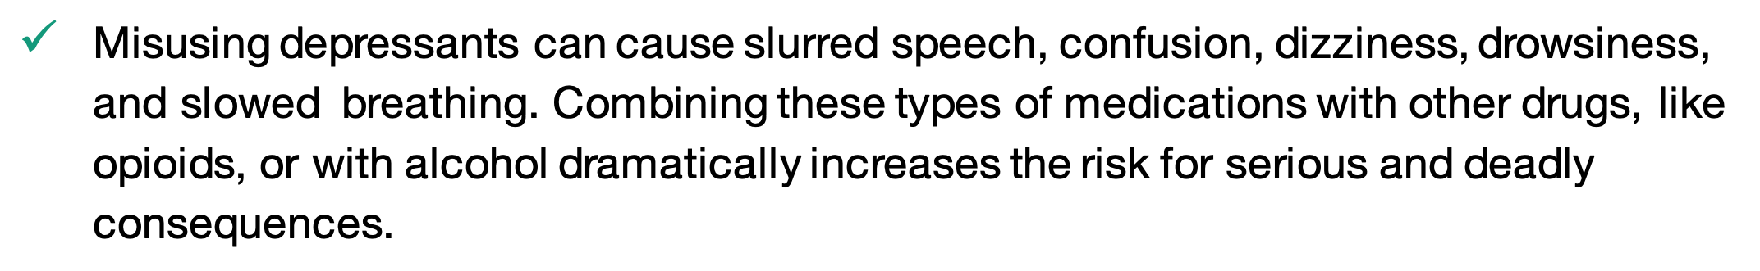
The nervous system is made up of two parts—the central nervous system and the peripheral nervous system.
Stimulants and depressants have different effects on the brain and nervous system.
Misusing prescription stimulants can cause psychosis, paranoia, heart attack, or stroke.
Misusing depressants can cause slurred speech, confusion, dizziness, drowsiness, and slowed breathing. Combining these types of medications with other drugs, like opioids, or with alcohol dramatically increases the risk for serious and deadly consequences.
Endorphins are natural pain blockers produced by the central nervous system.
Opioids mimic endorphins and can provide a feeling of euphoria.
Opioids bind to receptors in the brain to block pain messages from the nervous system.
Notes:
Instructor Notes:
Facilitate students’ reflection on their learning by reviewing the following points:
The nervous system is made up of two parts — the central nervous system and the peripheral nervous system.
Stimulants and depressants have different effects on the brain and nervous system.
Misusing prescription stimulants can cause psychosis, paranoia, heart attack, or stroke.
Misusing depressants can cause slurred speech, confusion, dizziness, drowsiness, and slowed breathing. Combining these types of medications with other drugs, like opioids, or with alcohol dramatically increases the risk for serious and deadly consequences.
Endorphins are natural pain blockers produced by the central nervous system.
Opioids mimic endorphins and can provide a feeling of euphoria.
Opioids bind to receptors in the brain to block pain messages from the nervous system.

Slide 18
It is important to use prescription medication as prescribed. Misusing prescription medications is illegal and dangerous.
Common symptoms of substance misuse can be physical, behavioral, or be displayed in new habits or preoccupations.
Substance misuse can alter brain function. Teen brains are even more at risk since they’re still developing.
Misusing substances, like prescription opioids, can lead to addiction or a substance use disorder.
Naloxone is a potentially life-saving medication that can stop or reverse the effects of an opioid overdose.
Good Samaritan Laws protect people who call 911 to get help for a friend, even if they have also been misusing substances.
The words we use matter! Avoid using stigmatizing language.
Seek guidance from a trusted adult if you have questions or need help. "Human Resources” can include parents, teachers, doctors, coaches, etc.
Notes:
Instructor Notes:
It is important to use prescription medication as prescribed. Misusing prescription medications is illegal and dangerous.
Common symptoms of substance misuse can be physical, behavioral, or be displayed in new habits or preoccupations.
Substance misuse can alter brain function. Teen brains are even more at risk since they’re still developing.
Misusing substances, like prescription opioids, can lead to addiction or a substance use disorder.
Naloxone is a potentially life-saving medication that can stop or reverse the effects of an opioid overdose.
Good Samaritan Laws protect people who call 911 to get help for a friend, even if they have also been misusing substances.
The words we use matter! Avoid using stigmatizing language.
Seek guidance from a trusted adult if you have questions or need help. "Human Resources” can include parents, teachers, doctors, coaches, etc.
Pharmacists, before you leave, thank the classroom teacher and students for allowing you to join them today, and encourage them to apply what they have learned during this activity and help bring awareness to opioid misuse by sharing their learning with family and friends.

Slide 19
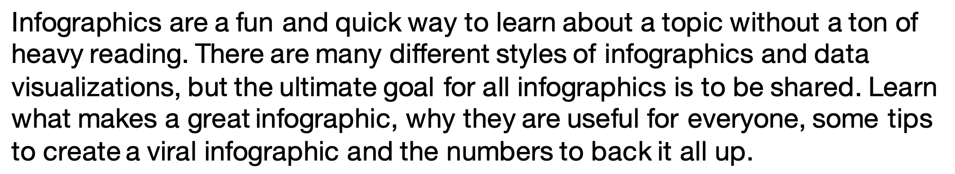


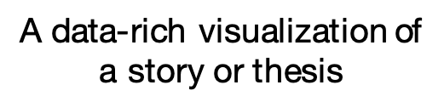
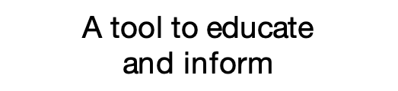
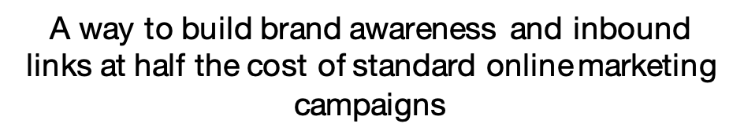
Notes:
Instructor notes
Tell students that in order to share what they have learned about opioids; they will create a public awareness infographic to educate their peers about the risks of opioid misuse.
Explain that an infographic is a way to communicate information quickly using pictures, charts, and just a little text. Reference the image.

Slide 20
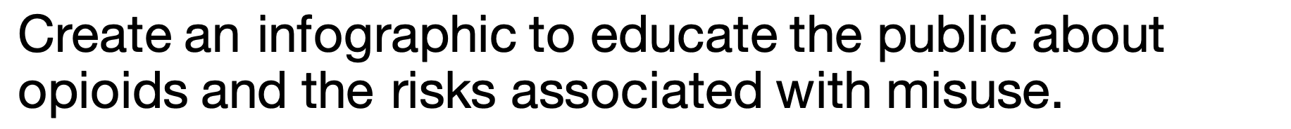
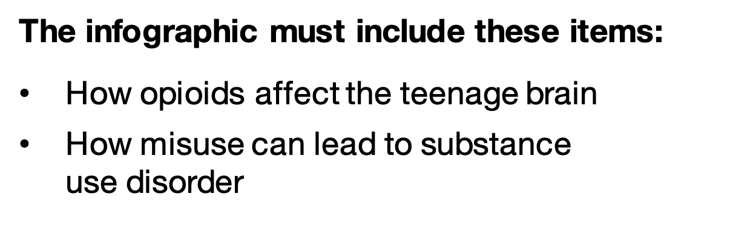



The infographic must include these items:
How opioids affect the teenage brain
How misuse can lead to substance
use disorder
Notes:
Instructor Notes:
Inform students that they will be creating a public service infographic to inform others about the risks associated with opioid misuse.
Distribute one Public Awareness Infographic handout and one computer to each student.
Technology Note: If computers aren’t available, distribute white paper and art supplies to each student.
Click to review the requirements of each infographic:
How opioids affect the teenage brain
How misuse can lead to substance use disorder
If using computers, direct students to the free online program you would like them to use to make their infographics (Canva, Piktochart, Snappa, Visme, Infogram, Venngage, Easel.ly).
Click to reveal the timer. Enter the time you are giving students to complete their infographic. Set the timer for 15 minutes (45-minute session) or 25 minutes (60-minute session).
Note: If using printed version of PowerPoint, use a stopwatch or smartphone clock app to keep time.
If time allows, have students present their Public Awareness Infographics to the class.
Adjust the timer by entering the animation settings > animation pane. Change the timing of the ‘Oval’. Note: the timing has to be entered in seconds.

